Slide 1


Surveying how Parallel Programming Models Address Computation Distribution
Insights on what makes parallel programming difficult and how to compare and judge programming models that aim to alleviate these difficulties
Presentation by: Andy Stone
April 27, 2010
Research Exam
Slide 1
Andy Stone
Research Exam

Slide 2
Surveying how Parallel Programming Models Address Computation Distribution
Insights on what makes parallel programming difficult and how to compare and judge programming models that aim to alleviate these difficulties
Presentation by: Andy Stone
April 27, 2010
Research Exam
Slide 2
Andy Stone
Research Exam

Slide 3
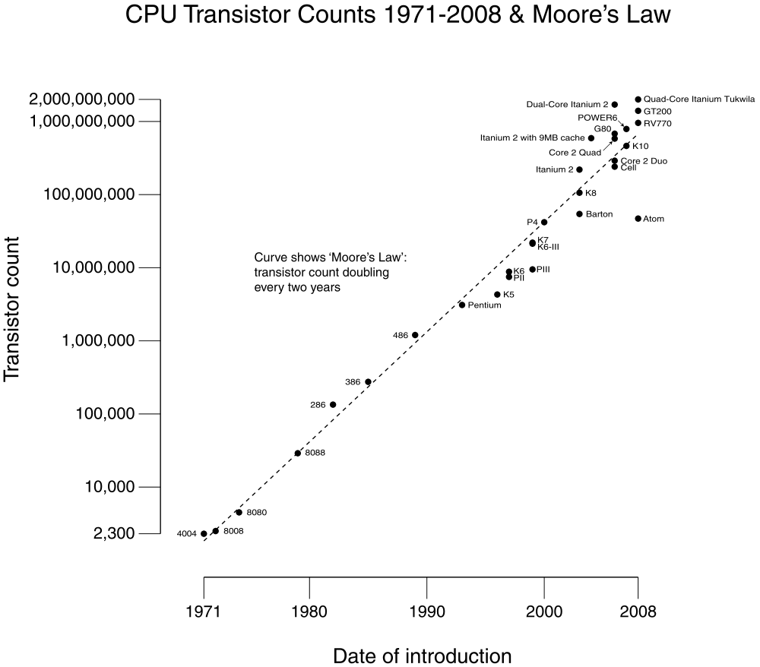
A Promising Growth Trend
http://en.wikipedia.org/wiki/File:Transistor_Count_and_Moore%27s_Law_-_2008.svg
Slide 3
Research Exam
Andy Stone
Research Exam
Notes:
Past performance is not an indicator of future success

Slide 4
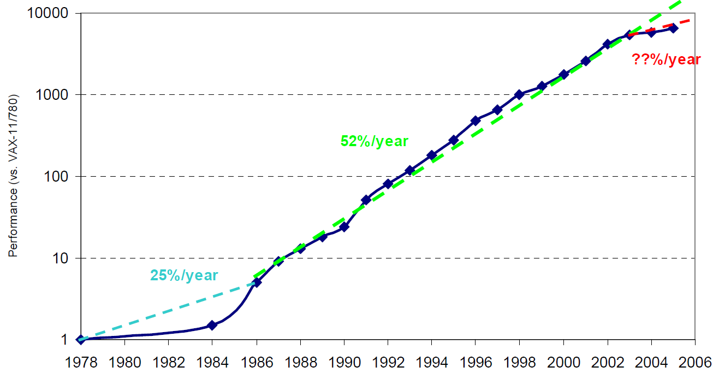
A Promising Growth Trend
Image from Berkeley View White-Paper (The Landscape of Parallel Computing Research: A View from Berkeley) http://www.eecs.berkeley.edu/Pubs/TechRpts/2006/EECS-2006-183.html
They take it from a book by Hennessy and Patterson: J. Hennessy and D. Patterson, Computer Architecture: A Quantitative Approach, 4th eddition, Morgan Kauffman, San Francisco, 2007
Slide 4
Research Exam
Andy Stone
Research Exam
Notes:
Past performance is not an indicator of future success

Slide 5
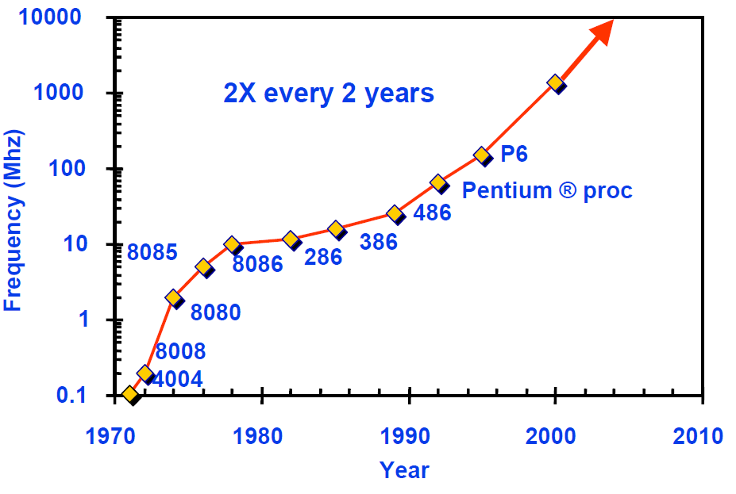
Another Growth Trend
http://www.nd.edu/~jbb/cse462_06/lectures/L03_Trends.pdf
Slide 5
Andy Stone
Research Exam

Slide 6
A Promising Growth Trend
Not so
Sun’s
10000
Surface
Rocket
1000
Nozzle
Nuclear
100
Power Density (W/cm²)
Reactor
Hot Plate
8086
10
4004
P6
8008
8085
386
Pentium®
8080
286
486
1
1970
1980
1990
2000
2010
Year
http://www.eng.auburn.edu/~agrawvd/D&TSEMINAR_SPR06/SLIDES/Agrawal_DTSem06.ppt
Source: Intel®
Slide 6
Andy Stone
Research Exam

Slide 7
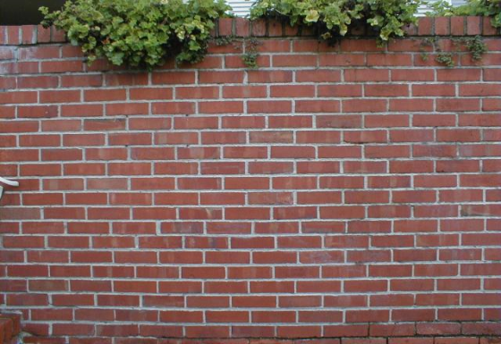

The power wall
The power wall is preventing further increases in processor operating frequency
How do I get more performance?
slow sauce
CPU Operating Frequency
Freakin' fast
Images from:
http://www.math.toronto.edu/~drorbn/Gallery/Symmetry/Tilings/2S22/BrickWall.jpg
http://computer-reviews.net/files/Intel%20Pentium%204%20530%203.0GHz%20800MHz%20bus%20Socket%20775.jpg
Slide 7
Andy Stone
Research Exam

Slide 8

How to get additional performance
Solution: Use more processing elements!
Parallel Architectures:
Multicore!
SMP!
Clusters!
Cloud Computing!
Don't worry CPU;
Just add some buddies:
slow sauce
CPU Operating Frequency
Freakin' fast
Images from:
http://www.math.toronto.edu/~drorbn/Gallery/Symmetry/Tilings/2S22/BrickWall.jpg
http://computer-reviews.net/files/Intel%20Pentium%204%20530%203.0GHz%20800MHz%20bus%20Socket%20775.jpg
http://cryptik.net/catalog/images/img_1614_intel-core2-duo.jpg
Slide 8
Andy Stone
Research Exam

Slide 9
Surveying how Parallel Programming Models Address Computation Distribution
Insights on what makes parallel programming difficult and how to compare and judge programming models that aim to alleviate these difficulties
Presentation by: Andy Stone
April 27, 2010
Research Exam
Slide 9
Andy Stone
Research Exam

Slide 10
What is software going to look like?
Parallel software faces challenges unseen in serial software
What are these challenges?
Think about how a parallel system differs from a serial system,
and think of what changes are required to port software from a serial
system to a parallel system
Slide 10
Andy Stone
Research Exam

Slide 11
Serial Architecture
Data
0110101011
0110101001
1010101110
0110101110
Processing Element
Memory
Instructions
Program counter
Slide 11
Andy Stone
Research Exam

Slide 12
Shared Memory, Parallel Architecture
Processing Element
Memory
Data
0110101011
0110101001
1010101110
0110101110
Processing Element
Instructions
. . .
Program counters
Processing Element
Slide 12
Andy Stone
Research Exam

Slide 13
Distributed Memory, Parallel Architecture
Data
0110101011
011010
Processing Element
Memory
Instructions
Processing Element
Memory
Data
01101001
1010100101
Interconnect
Instructions
. . .
. . .
Data
Processing Element
Memory
11001010
0110101110
Instructions
Slide 13
Andy Stone
Research Exam

Slide 14
Three Factors
Distribution of Computation
0110101011
0110101001
1010101110
0110101110
Distribution of Data
Communication
Slide 14
Andy Stone
Research Exam

Slide 15









How to address these factors?
Programming models of course!
Cilk
Ct
CHAPEL
STAPL
Map-Reduce
CUDA
Slide 15
Andy Stone
Research Exam

Slide 16
Surveying how Parallel Programming Models Address Computation Distribution
Insights on what makes parallel programming difficult and how to compare and judge programming models that aim to alleviate these difficulties
Presentation by: Andy Stone
April 27, 2010
Research Exam
Slide 16
Andy Stone
Research Exam

Slide 17
Surveying how Parallel Programming Models Address Computation Distribution
Insights on what makes parallel programming difficult and how to compare and judge the programming models that aim to alleviate these difficulties
Presentation by: Andy Stone
Distribution of Computation
April 27, 2010
Research Exam
Slide 17
Andy Stone
Research Exam

Slide 18

Two types of criteria:
?
Interpretive
Evaluative
Image from: http://www.tulanelink.com/legal/balance2.gif
Slide 18
Andy Stone
Research Exam
Notes:
what do you mean by "criteria"

Slide 19
Four Interpretive Criteria
The specification of how computation is distributed across processing elements
1
The specification of how computation is distributed across time
2
3
The structure of computation
1
The realization of distributed computation
2
3
Slide 19
Andy Stone
Research Exam

Slide 20
Evaluating programming models
Given the set of computation a model represents
_{How well can they run?}
Where can they run?
_{What can they run?}
_{Who can they run with?}
What do they demand of the programmer?
Slide 20
Andy Stone
Research Exam

Slide 21
Lots of Evaluative Criteria
_{How well can they run?}
Performance
Fault-tolerance
Testability
Where can they run?
Portability
Slide 21
Andy Stone
Research Exam

Slide 22
Lots and lots of Evaluative Criteria
_{What can they run?}
Expressability
User-Control
Adaptability
_{Who can they run with?}
Interoperability
Composability
Slide 22
Andy Stone
Research Exam

Slide 23
Lots^3 of Evaluative Criteria
What do they demand of the programmer?
User-Responsibility
Clarity
Slide 23
Andy Stone
Research Exam

Slide 24
Surveying how Parallel Programming Models Address Computation Distribution
Insights on what makes parallel programming difficult and how to compare and judge programming models that aim to alleviate these difficulties
Presentation by: Andy Stone
April 27, 2010
Research Exam
Slide 24
Andy Stone
Research Exam

Slide 25
Structure of the Survey
 | Model 1 | Model 2 | ... | Model N
Impact on portability
1
2
?
3
1
2
3
...
See: Appendix A
Slide 25
Andy Stone
Research Exam

Slide 26
The programming models
Iterators In Chapel
Sequoia
Granules
Id-Nouveau
Tang and Xue's Model for Tiled Code Generation
Slide 26
Andy Stone
Research Exam

Slide 27
The programming models
Iterators In Chapel
Sequoia
Granules
Id-Nouveau
Tang and Xue's Model for Tiled Code Generation
Separating iteration logic from loop-body
M. Joyner, B. L. Chamberlain, and S. J. Deitz. Iterators in chapel. In 11th International Workshop on High-Level Parallel Programming Models and Supportive Environments (HIPS), April 2006.
Slide 27
Andy Stone
Research Exam

Slide 28
Chapel iterators
Specification of comp. dist across time
1
2
3
for (row,col) in a 6x6 iteration space {
writeln("At index: ", row, " ", col);
}
How to step through this iteration space?
row
col
Slide 28
Andy Stone
Research Exam

Slide 29
Chapel iterators
Specification of comp. dist across time
1
2
3
RowOrder
row
col
Slide 29
Andy Stone
Research Exam

Slide 30
Chapel iterators
Specification of comp. dist across time
1
2
3
ColOrder
row
col
Slide 30
Andy Stone
Research Exam

Slide 31
Chapel iterators
Specification of comp. dist across time
1
2
3
for (row,col) in a rowOrder(6,6) {
writeln("At index: ", row, " ", col);
}
def rowOrder(nRows, nCols) {
for row in 1..nRows
forall col in 1..nCols
yield (row, col);
}
def colOrder(nRows, nCols) {
for col in 1..nCols
forall row in 1..nRows
yield (row, col);
}
row
col
Slide 31
Andy Stone
Research Exam

Slide 32
Chapel, Evaluated
 | Chapel
 | Iteration logic specified in an iterator (written like a function)
Portability | Separation of iteration logic enables new logic to easily be added and changed; if iteration logic is machine dependent this separation aids in portability.
Expressability | Iterators are written in same language as algorithms
Composability | Iterators can be embedded in other iterators
Clarity | Separation of concerns improves clarity
1
2
3
1
2
3
Slide 32
Andy Stone
Research Exam

Slide 33
The programming models
Iterators In Chapel
Sequoia
Granules
Id-Nouveau
Tang and Xue's Model for Tiled Code Generation
Addressing the memory hierarchy
K. Fatahalian, T. J. Knight, M. Houston, M. Erez, D. R. Horn, L. Leem, J. Y. Park, M. Ren, A. Aiken, W. J. Dally, and P. Hanrahan. Sequoia: Programming the memory hierarchy. In Proceedings of the 2006 ACM/IEEE Conference on Supercomputing, 2006.
Slide 33
Andy Stone
Research Exam

Slide 34
Sequoia
The Memory Hierarchy
Small capacity,
High Speed
CPU Registers
L1 Cache
L2 Cache
Local physical memory
Remote memory
Large capacity,
Slow Speed
Slide 34
Andy Stone
Research Exam
Notes:
Talk about virtual memory

Slide 35
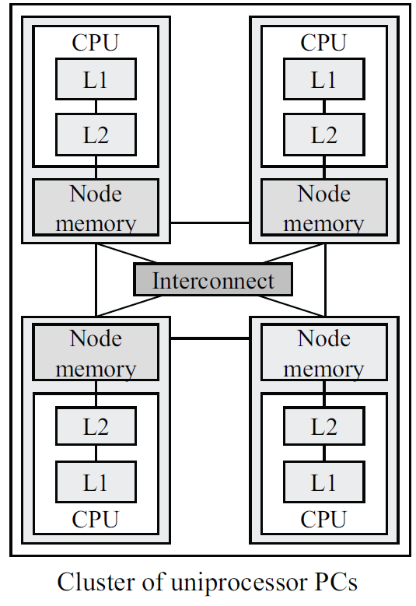
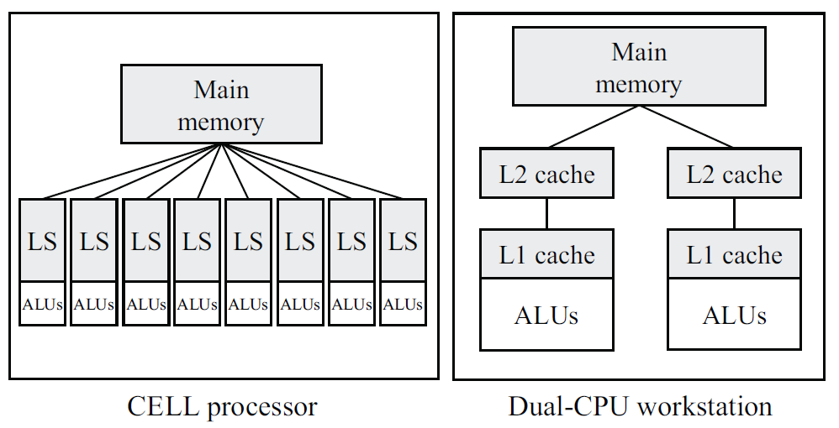
Sequoia
Arrangements of Memory Hierarchy
Slide 35
Andy Stone
Research Exam

Slide 36
Sequoia
Realization of Distributed computation
1
2
3
Data
Data
Data
Data
Data
Data
Data
Data
Data
Data
Data
Data
Data
Data
Data
Data
Data
Data
Data
Data
Data
Data
Data
Data
Data
Data
Slide 36
Andy Stone
Research Exam
Notes:
Talk about virtual memory

Slide 37
Sequoia, Evaluated
 | Sequoia
 | Recursively decompose data to fit on successive layers of hierarchy.
Portability | Memory hierarchies are machine dependent. Application can be ported to operate with different memory hierarchies by modifying mapping specification files (that describe this hierarchy)
Expressability | Limited to decomposition of arrays.
Testability | No clear way to tell if data is actually moving to appropriate levels of memory hierarchy.
1
2
3
1
2
3
Slide 37
Andy Stone
Research Exam

Slide 38
The programming models
Iterators In Chapel
Sequoia
Granules
Id-Nouveau
Tang and Xue's Model for Tiled Code Generation
Have runtime allocate tasks to resources in the cloud.
S. Pallickara, J. Ekanayake, and G. Fox. An overview of the granules runtime for cloud computing. In Proceedings of the IEEE International Conference on e-Science,
December 2008.
Slide 38
Andy Stone
Research Exam

Slide 39
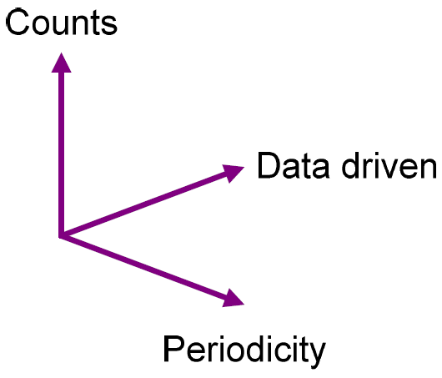
Granules
Specification of comp. dist across time
1
2
3
Counts:
How many times should a task execute
Data driven
Execute on data-availability
Periodicity
Execute every n milliseconds
Can also express termination condition
Slide 39
Andy Stone
Research Exam

Slide 40
Granules, Evaluated
 | Sequoia
 | Specified via scheduling strategies
Portability | Runtime system moves computation to computing resources, updates in runtime system to operate with new types of resources
Expressability | Expressability improved by enabling a combination and conditionality of counts/data-driven/periodicity parameters
1
2
3
1
2
3
Slide 40
Andy Stone
Research Exam

Slide 41
The programming models
Iterators In Chapel
Sequoia
Granules
Id-Nouveau
Tang and Xue's Model for Tiled Code Generation
Determine computation distribution from an explicit decomposition of data
A. Rogers and K. Pingali. Process decomposition through locality of reference. In Proceedings of the ACM SIGPLAN Conference on Programming Language Design and Implementation, pages 69{80, New York, NY, USA, 1989. ACM.
Slide 41
Andy Stone
Research Exam

Slide 42
Id-Nouveau
Specification of comp. dist. across procs.
Computation distribution follows from data distribution
Compiler automatically determines how to distribute
computation
The data structure of Id-Nouveau is the I-Structure
Has single assignment semantics
Slide 42
Andy Stone
Research Exam

Slide 43
Id-Nouveau
Specification of comp. dist. across procs.
Array Mapping
Map: Maps indices to processing element
Local: Maps index to local element
Alloc: Allocates the array
Slide 43
Andy Stone
Research Exam

Slide 44
Id-Nouveau, Evaluated
 | Sequoia
 | Explicitly distribute data, computation distribution follows from the data-distribution
Expressability | Limited to operating on arrays with single-assignment semantics
Testability | Improved since code maintains serial semantics
Clarity | Code appears serial
1
2
3
1
2
3
Slide 44
Andy Stone
Research Exam

Slide 45
The programming models
Iterators In Chapel
Sequoia
Granules
Id-Nouveau
Tang and Xue's Model for Tiled Code Generation
Define a geometric structure to computation, distribute computation in that structure
P. Tang and J. Xue. Generating efficient tiled code for distributed memory machines. Parallel Computing, 26(11):1369 { 1410, 2000.
Slide 45
Andy Stone
Research Exam

Slide 46
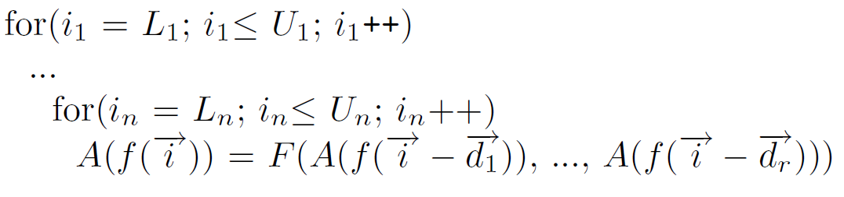


Tang and Xue's Model for Tiled Code
Structure of Computation
Where:
Slide 46
Andy Stone
Research Exam

Slide 47
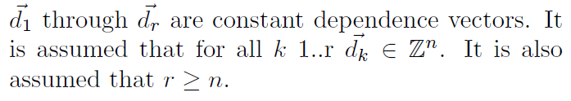
Tang and Xue's Model for Tiled Code
Structure of Computation
Where:
Slide 47
Andy Stone
Research Exam

Slide 48
Tang and Xue's Model, Evaluated
 | Sequoia
 | See previous two slides
Portability | Could be improved with a more espressible model (multi-level tiling, other mapping strategies, etc.)
Expressability | Can only handle singe assignments and uniform loop-carry dependencies
1
2
3
1
2
3
Slide 48
Andy Stone
Research Exam

Slide 49
Surveying how Parallel Programming Models Address Computation Distribution
Insights on what makes parallel programming difficult and how to compare and judge programming models that aim to alleviate these difficulties
Presentation by: Andy Stone
April 27, 2010
Research Exam
Slide 49
Andy Stone
Research Exam

Slide 50
Conclusions
Examining programming models in terms of interpretive and evaluative criteria aids in comparing and judging them
In some systems computation distribution follows from data distribution
  This is true in Id-Nouveau and Sequoia not in Tang and Xue's model
Computation distribution is not an isolated issue
  I had to talk about data distribution in order to explain how to specify comp. distribution in Id-Nouveau
Slide 50
Andy Stone
Research Exam

Slide 51
Conclusions
Separating machine-specific concerns from algorithm improves program portability
Chapel and Sequoia illustrate this point nicely.
Adaptability is influenced by how closely a model's structure of computation matches the structure of the program that is being adapted.
  Loops are easy to port to Chapel
  Porting to Id-Nouveau will be hard if your program isn't written with single-assignment semantics in mind
  If porting to fit into Tang & Xue's model you better have uniform dependencies.
Slide 51
Andy Stone
Research Exam

Slide 52
Future Work
New and improved models:
Identify limitations in model according to the identified evaluative criteria, change the model to overcome these limitations or come up with something new that will
Finding better ways of comparing and judging models:
Survey how models address other two factors
Examine patterns of computation and how models help them
Slide 52
Andy Stone
Research Exam

Slide 53
Acknowledgements
Committee members
Chinese surname pronunciation help
Michelle Strout
Daniel Massey
Shrideep Pallickara
Simon Sui
Editorial assistance
Practice presentation audience
Alan Lamielle
Jon Roelofs
Programming models for HPC reading-group
Other research exams
Chris Krieger
Slide 53
Andy Stone
Research Exam

Slide 54
BONUS SLIDES

Slide 55
Sequoia
Structure of Computation
Language includes:
tunable parameters
set to values specific to level of hierarchy computation is at
blocking primitives
decompose data (to fit on successive layers of hierarchy).
mapping primitives
spawn subtasks to work on decomposed data
Slide 55
Andy Stone
Research Exam

Slide 56
Sequoia
Structure of Computation
Instance Structure
Mapping
Specification File
Instance Structure
...
Sequoia Compiler
Instance Structure
Sequoia Program
Leaf Variant
Inner Variant
Slide 56
Andy Stone
Research Exam

Slide 57
ANIMATION SLIDES

Slide 58
Sequoia
Realization of Distributed computation
1
2
3
Data
Slide 58
Andy Stone
Research Exam
Notes:
Talk about virtual memory

Slide 59
Sequoia
Realization of Distributed computation
1
2
3
Data
Data
Data
Slide 59
Andy Stone
Research Exam
Notes:
Talk about virtual memory

Slide 60
Sequoia
Realization of Distributed computation
1
2
3
Data
Data
Slide 60
Andy Stone
Research Exam
Notes:
Talk about virtual memory

Slide 61
Sequoia
Realization of Distributed computation
1
2
3
Data
Data
Data
Data
Slide 61
Andy Stone
Research Exam
Notes:
Talk about virtual memory

Slide 62
Sequoia
Realization of Distributed computation
1
2
3
Data
Data
Slide 62
Andy Stone
Research Exam
Notes:
Talk about virtual memory

Slide 63
Sequoia
Realization of Distributed computation
1
2
3
Data
Data
Slide 63
Andy Stone
Research Exam
Notes:
Talk about virtual memory

Slide 64
Sequoia
Realization of Distributed computation
1
2
3
Data
Data
Slide 64
Andy Stone
Research Exam
Notes:
Talk about virtual memory

Slide 65
Sequoia
Realization of Distributed computation
1
2
3
Data
Data
Data
Data
Slide 65
Andy Stone
Research Exam
Notes:
Talk about virtual memory

Slide 66
Sequoia
Realization of Distributed computation
1
2
3
Data
Data
Slide 66
Andy Stone
Research Exam
Notes:
Talk about virtual memory

Slide 67
Sequoia
Realization of Distributed computation
1
2
3
Data
Data
Slide 67
Andy Stone
Research Exam
Notes:
Talk about virtual memory

Slide 68
Sequoia
Realization of Distributed computation
1
2
3
Data
Data
Slide 68
Andy Stone
Research Exam
Notes:
Talk about virtual memory

Slide 69
Sequoia
Realization of Distributed computation
1
2
3
Data
Slide 69
Andy Stone
Research Exam
Notes:
Talk about virtual memory

