Slide 1
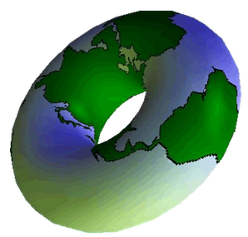



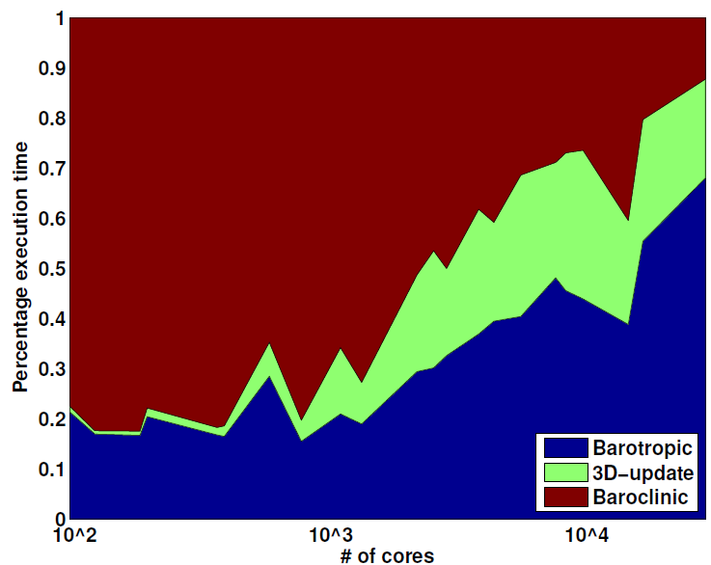
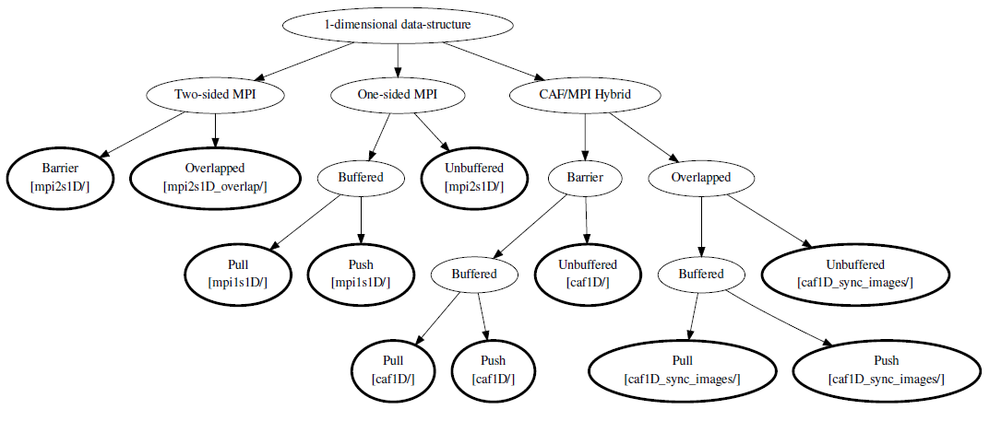
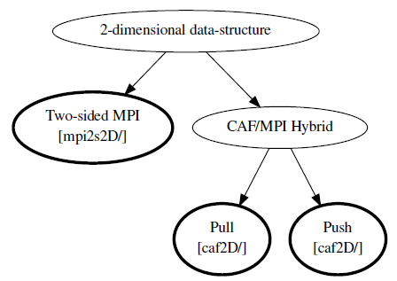
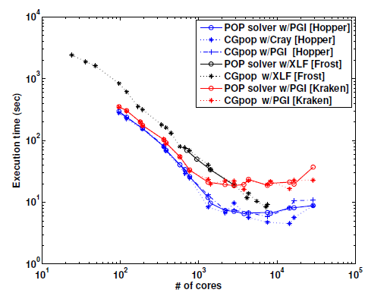
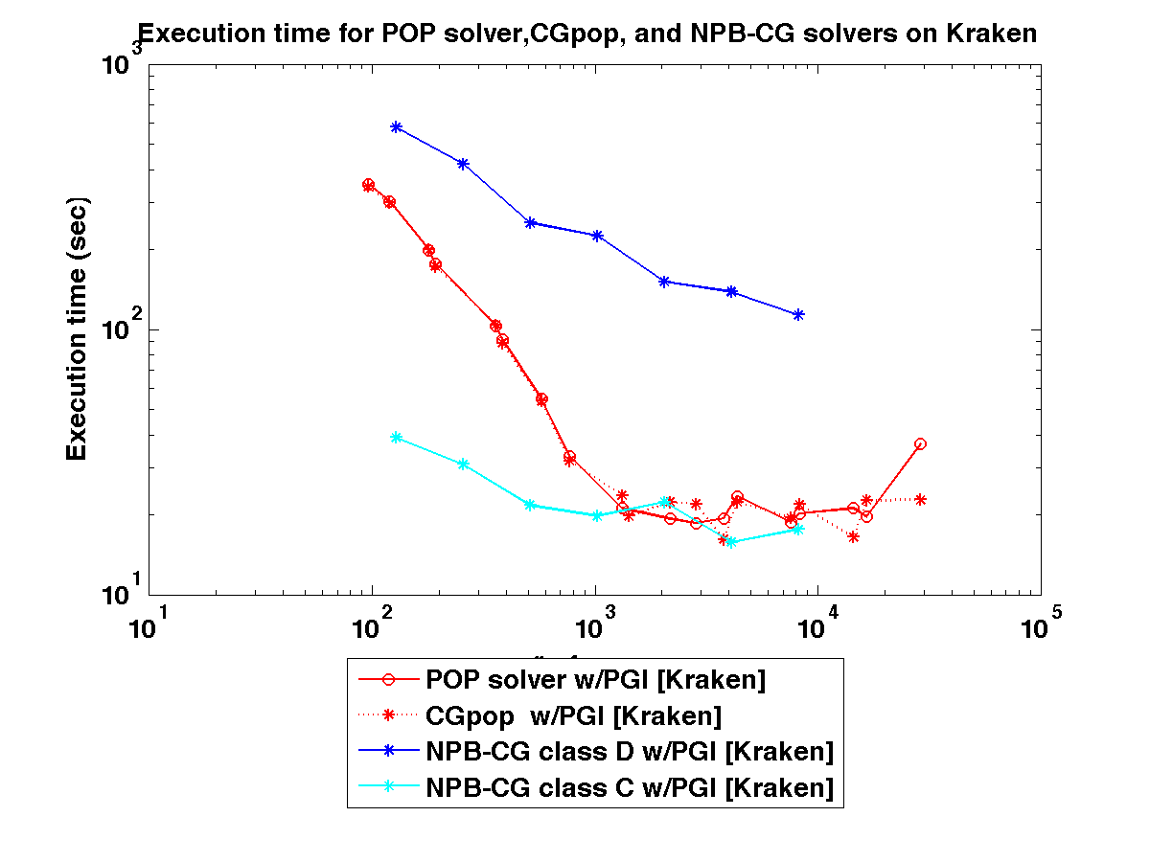
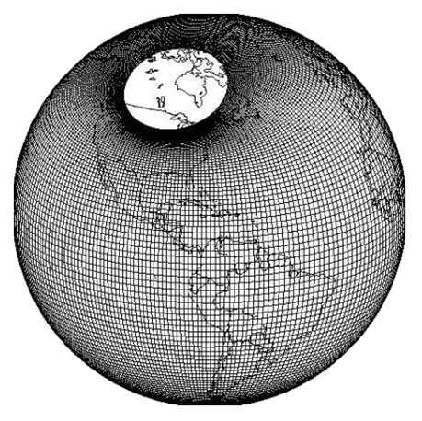
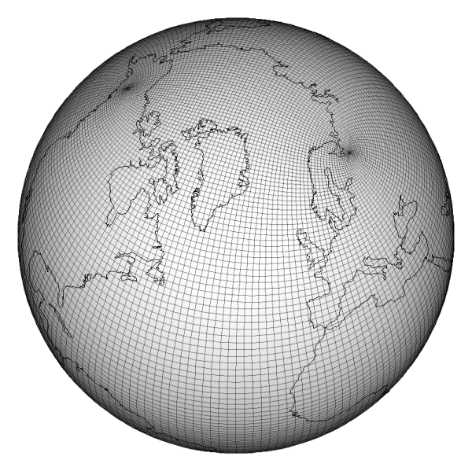
The CGPOP Miniapp
Andrew Stone, John Dennis, Michelle Mills Strout
(Colorado State University) (NCAR) (Colorado State University)
Separating Algorithm and Implementation
via Model Injection (SAIMI, DOE #DE-SC3956)
POP and CGPOP
Variants
The Parallel Ocean Program (POP):
  An important multi-agency code
  Simulates Surface Pressure of Earth's Oceans over time
  More than 70 KLOC
Turning POP into a miniapp:
CGPOP:
  Conjugate gradient solver in POP (Parallel Ocean Program)
  About 3 KLOC
We implemented several different variants of CGPOP:
  subdomain data structure (sparse one-dimensional array or dense two-dimensional array),
  communication mechanism (e.g., two-sided MPI, one-sided MPI, or Co-Array Fortran),
  optimizations such as buffering of data, communication overlap, and whether data is pushed or pulled in for the one-sided versions.
Full Application
Express performance critical subcomputations in restricted programming models.
Express implementation details as transformations of sub-computations.
Evaluate injectable programming models with DOE miniapps.
#pragma <alg> <details A>
#pragma <alg> <details B>
Relative cost of the baroclinic component dominates at fewer than 1000 cores
Barotropic and 3D-update dominate at greater than 1000 cores
We extracted CGPOP
from the barotropic component, and the conjugate gradient algorithm within it specifically.
Source to Source Compilation Tool
Optimized Code for Machine A
Optimized Code for Machine B
This won’t hurt a bit!
About Miniapps
For large simulation applications researchers are investigating new programming models, data-structures, and algorithms
Benchmarks are traditionally used to evaluate new techniques.
Performance on medium-sized benchmarks do not always translate to performance on large simulation codes.
Solution
Take a real world application and create a smaller proxy app that models its performance
Make changes on the smaller app to infer how the changes would impact the larger one.
NAS CG is a popular conjugate gradient benchmark. However, it does not accurately model the performance of the POP application.
CGPOP is a performance proxy for POP on three different systems using two different compilers.
Comparing the performance of the two-sided
two-dimensional MPI variant against several CAF variants
Future Work
Future work in SAIMI includes separating grid details from algorithm.
CGPOP currently uses dipole grid (pictured on left)
Use SAIMI approach to generate a version of CGPOP that uses a tripole grid (pictured on right)
Download CGPOP package at:
http://www.cs.colostate.edu/hpc/cgpop

