Slide 1
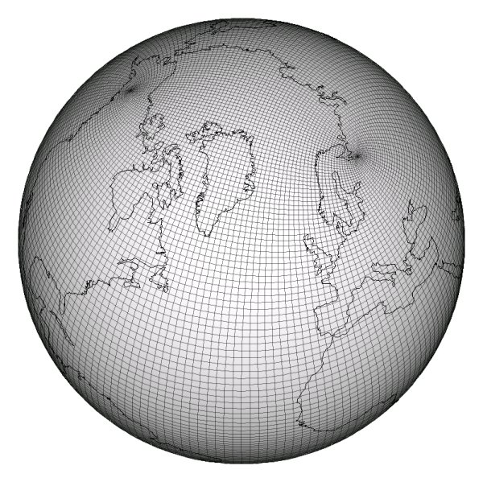


Evaluating CAF with the CGPOP Miniapp
Andrew Stone
Colorado State University
John Dennis (NCAR)
Michelle Strout (Colorado State)
Andrew Stone Slide 1

Slide 2
Outline
Using PGAS in POP?
The CGPOP Miniapp
Evaluating CAF
Andrew Stone Slide 2

Slide 3
Outline
Using PGAS in POP?
The CGPOP Miniapp
Evaluating CAF
Andrew Stone Slide 3

Slide 4









Motivating Example
POP is an Ocean simulation code.
Currently Fortran + MPI
About 70 KLOC
Should PGAS be used in POP to improve maintainability?
Ct
Cilk
STAPL
Map-Reduce
Adoption affected by:
Need to work with existing POP code
Need to maintain high performance
Whether a model is shown to improve similar code
The experience developers have with the model
Andrew Stone Slide 4

Slide 5
Examining Existing Benchmarks
Benchmarks are small (in terms of SLOC) programs that perform some common type of computation.
High-performance LINPACK
NAS parallel benchmarks
HPC Challenge benchmarks
The main computation in POP is its conjugate gradient solver
So maybe we should see how well programming models implement NAS CG?
But does NAS CG accurately model POP?
Andrew Stone Slide 5

Slide 6
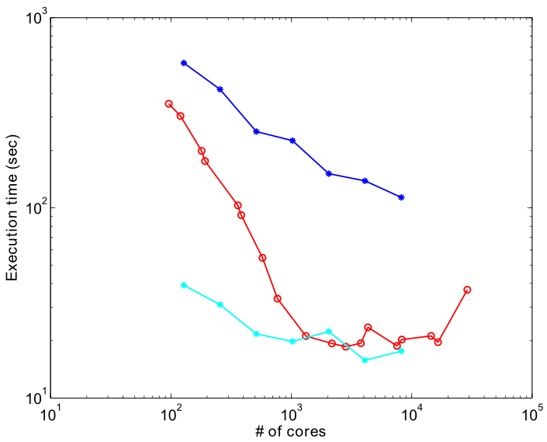

NPB Vs. POP
NAS does not model the performance of POP’s CG solver
Andrew Stone Slide 6

Slide 7
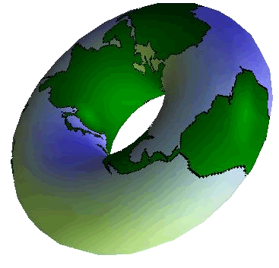
How NAS and POP differ
POP has:
Specific boundary conditions
Specific data-distribution and data-structures to represent distribution
Application specific optimizations (don’t store/compute land points for an Ocean simulation)
Solution:
Small pieces of code (1k - 10k SLOC) extracted from POP.
A Miniapp!
Andrew Stone Slide 7
Notes:
Explicitly mention that the earth is a sphere

Slide 8
Outline
Evaluating Programming Models
The CGPOP Miniapp
Evaluating CAF
Andrew Stone Slide 8

Slide 9
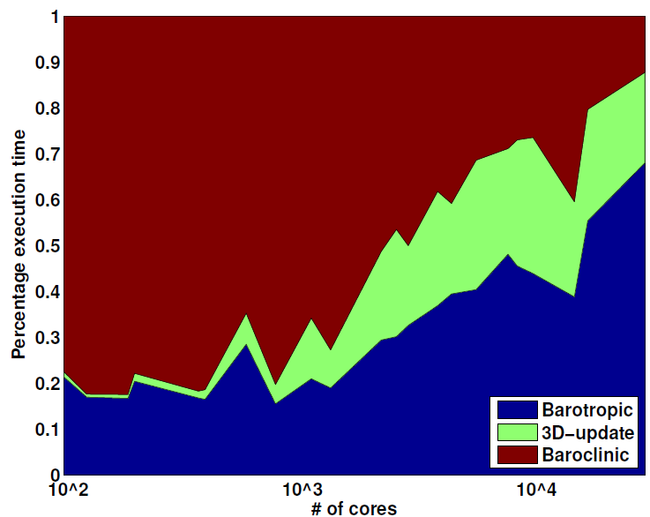
Developing a Miniapp for POP
3600 x 2400 grid (strong scaling)
Relative cost of the baroclinic component dominates at fewer than 10000 cores
Barotropic and 3D-update dominate at greater than 10000 cores
We extracted CGPOP
from the barotropic component, and the conjugate gradient algorithm within it specifically.
Andrew Stone Slide 9

Slide 10
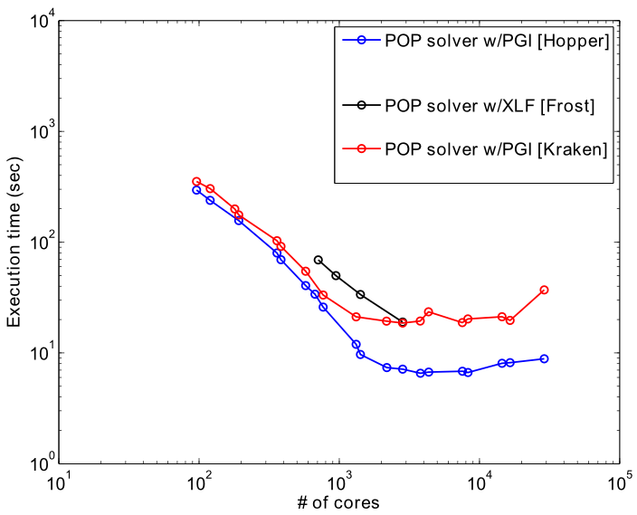
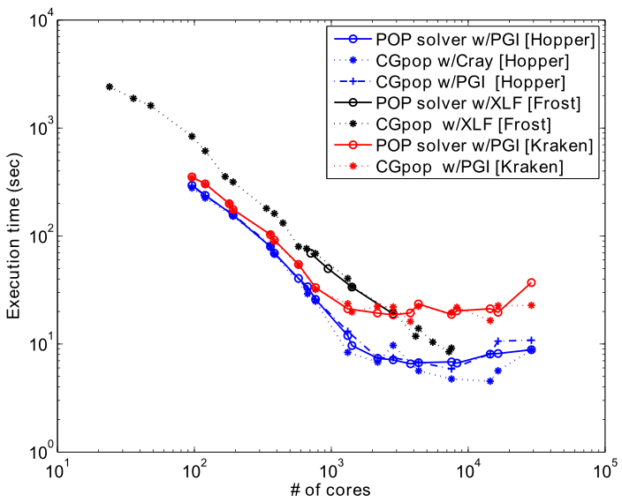
CGPOP as a Performance Proxy
Andrew Stone Slide 10

Slide 11
CGPOP Architecture
CGPOP is 3KLOC, how did we get it down to that size:
Timing
information
Input file
Domain decomposition generator
Intermediate state file
CGPOP Miniapp
L2 Norm of
CG output
627 MB
5 KLOC
3 KLOC
663 MB
Andrew Stone Slide 11

Slide 12
Outline
Evaluating Programming Models
The CGPOP Miniapp
Evaluating CAF
Andrew Stone Slide 12

Slide 13
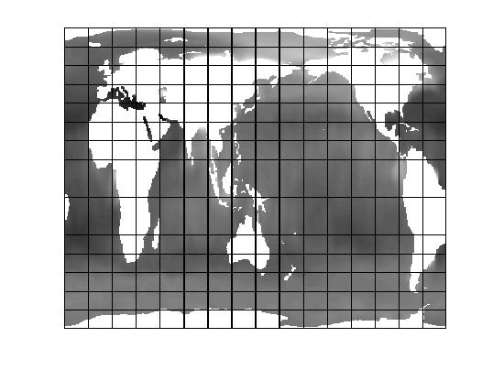
Two primary versions of CGPOP
Two versions:
World is conceptually big 2D array
World split into blocks
Processes take ownership of blocks
Land blocks are eliminated
In 2d version:
2D array
Neighboring points stored in ghost cells
In 1d version:
1D array with indirect access
Only ocean points are stored
Neighboring points stored in halo
Neither variant is best on all platforms
Andrew Stone Slide 13

Slide 14
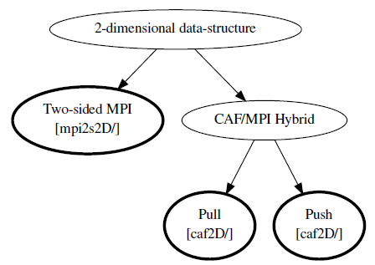
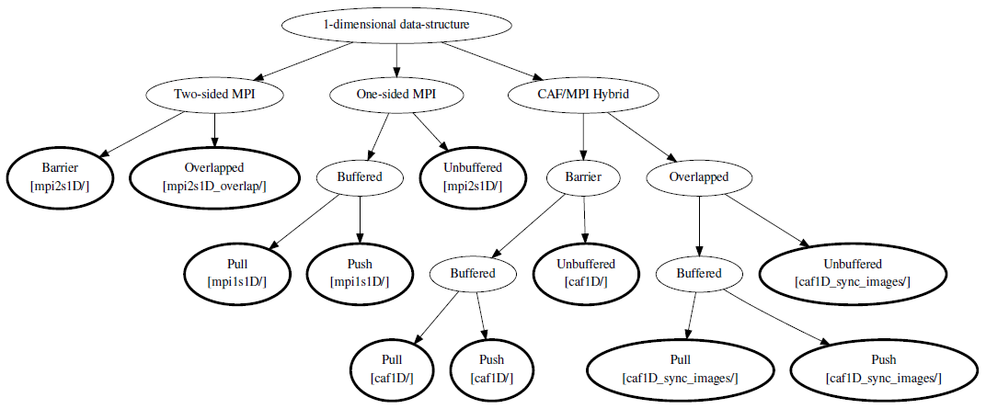
Many possible CAF implementations…
Differ on how they conduct the communication routine
Buffer data or don’t?
Push data or pull?
Overlap computation/communication or don’t?
It’s easier to explore this space with miniapp than fullapp
Andrew Stone Slide 14

Slide 15
An issue with all CAF versions
With 2-sided communication:
Sender | Receiver
Receiving proc ID | Sending proc ID
Address to send | Address to receive
With 1-sided push communication:
With 1-sided pull communication:
Sender | Receiver
Receiving proc ID
Address to pull from
Address to place into
Sender | Receiver
 | Sending proc ID
 | Address to pull from
 | Address to place into
Andrew Stone Slide 15

Slide 16
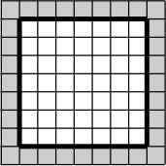
2D and 1D Data-Structures
CSR’d
Interior Points
Halo
Andrew Stone Slide 16

Slide 17
Initial MPI implementation
Communication to populate halo
Sender:
S-buffer:
R-buffer:
Receiver:
Andrew Stone Slide 17

Slide 18
Simple CAF Code for UpdateHalo
subroutine UpdateHalo ( array )
! ∗∗ Input parameters and local variables: ∗∗
real , intent(inout) :: array (:)[:]
integer :: I ! dummy counter
sync all
!∗∗∗
! iterate through halo elements , grabbing fresh
! values from remote images.
!∗∗∗
do i=startOfHaloIdx , endOfHaloIdx
array(i) = array(halo2grab(i))[haloOnProc(i)]
enddo
sync all
end subroutine UpdateHalo
Andrew Stone Slide 18

Slide 19
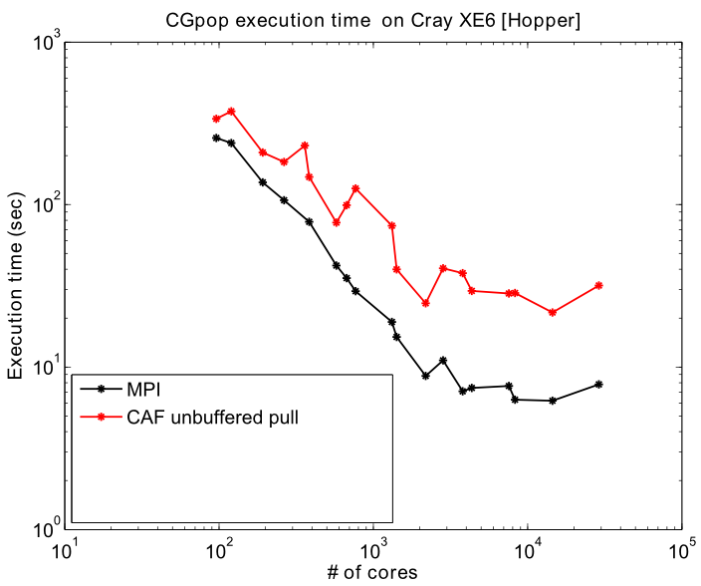
Need for Data Aggregation
Andrew Stone Slide 19

Slide 20
subroutine UpdateHalo(array)
! ** Input parameters and local variables: **
real(r8), intent(inout) :: array(:)
integer(i4) :: src,dest,len,iptr,tag
integer(i4) :: ierr,i, placeval,j
  ! ** Gather data to be sent into a buffer **
do i=1,lenSendBuffer
sendBuffer(i) = array(halo2send(i))
enddo
sync all
! ** Pull data from buffer to neighbors **
do i=1,nRecv
iptr = ptrRecv(i)
len = RecvCnt(i)
dest = rNeigh(i) + 1
pullval = pull(i)
BufferRecvDbl(iptr:iptr+len-1) = &
BufferSendDbl(pullval:pullval+len-1)[dest]
enddo
sync all
! ***
! Indirect address from the recvBuffer to the
! receiving side's array
! ***
do i=1,lenRecvBuffer
array(recv2halo(i)) = recvBuffer(i)
enddo
end subroutine UpdateHalo
Andrew Stone Slide 20

Slide 21
subroutine UpdateHalo(array)
! ** Input parameters and local variables: **
real(r8), intent(inout) :: array(:)
integer(i4) :: src,dest,len,iptr,tag
integer(i4) :: ierr,i, placeval,j
  ! ** Gather data to be sent into a buffer **
do i=1,lenSendBuffer
sendBuffer(i) = array(halo2send(i))
enddo
sync all
! ** Pull data from buffer to neighbors **
do i=1,nRecv
iptr = ptrRecv(i)
len = RecvCnt(i)
dest = rNeigh(i) + 1
pullval = pull(i)
BufferRecvDbl(iptr:iptr+len-1) = &
BufferSendDbl(pullval:pullval+len-1)[dest]
enddo
sync all
! ***
! Indirect address from the recvBuffer to the
! receiving side's array
! ***
do i=1,lenRecvBuffer
array(recv2halo(i)) = recvBuffer(i)
enddo
end subroutine UpdateHalo
Andrew Stone Slide 21

Slide 22
subroutine UpdateHalo(array)
! ** Input parameters and local variables: **
real(r8), intent(inout) :: array(:)
integer(i4) :: src,dest,len,iptr,tag
integer(i4) :: ierr,i, placeval,j
  ! ** Gather data to be sent into a buffer **
do i=1,lenSendBuffer
sendBuffer(i) = array(halo2send(i))
enddo
sync all
! ** Pull data from buffer to neighbors **
do i=1,nRecv
iptr = ptrRecv(i)
len = RecvCnt(i)
dest = rNeigh(i) + 1
pullval = pull(i)
BufferRecvDbl(iptr:iptr+len-1) = &
BufferSendDbl(pullval:pullval+len-1)[dest]
enddo
sync all
! ***
! Indirect address from the recvBuffer to the
! receiving side's array
! ***
do i=1,lenRecvBuffer
array(recv2halo(i)) = recvBuffer(i)
enddo
end subroutine UpdateHalo
Andrew Stone Slide 22

Slide 23
subroutine UpdateHalo(array)
! ** Input parameters and local variables: **
real(r8), intent(inout) :: array(:)
integer(i4) :: src,dest,len,iptr,tag
integer(i4) :: ierr,i, placeval,j
  ! ** Gather data to be sent into a buffer **
do i=1,lenSendBuffer
sendBuffer(i) = array(halo2send(i))
enddo
sync all
! ** Pull data from buffer to neighbors **
do i=1,nRecv
iptr = ptrRecv(i)
len = RecvCnt(i)
dest = rNeigh(i) + 1
pullval = pull(i)
BufferRecvDbl(iptr:iptr+len-1) = &
BufferSendDbl(pullval:pullval+len-1)[dest]
enddo
sync all
! ***
! Indirect address from the recvBuffer to the
! receiving side's array
! ***
do i=1,lenRecvBuffer
array(recv2halo(i)) = recvBuffer(i)
enddo
end subroutine UpdateHalo
Andrew Stone Slide 23

Slide 24
Resulting Performance
2x
3.9x
Andrew Stone Slide 24

Slide 25
Code Volume Comparison
Andrew Stone Slide 25

Slide 26
Suggestions for CAF
Analyze Code and Automatically Aggregate multiple sends conducted in a loop
Add gather/scatter operation to language:
array(recv2halo(:)) =
array(halo2send(:))[source(i)]
recv2halo – Lists elements to receive
halo2send – Lists elements to send
[source(i)] – Indicates to access an array on the sending proc
Andrew Stone Slide 26

Slide 27
Suggestions for CAF
Missing Reductions in standard
  Cray has reductions that work on certain machines
Explicit Synchronization Management
! dir$ pgas defer_sync
Andrew Stone Slide 27

Slide 28
Conclusions
CAF's strong points:
  Decreased line count with non-buffered version
  Can compile with existing Fortran compiler
  Easy learning curve
CAF's weak points:
  Had to explicitly buffer data
Adoption: a chicken and egg scenario
  Developers want to see studies examining applications similar to theirs.
  Compiler researchers need developers to help port applications (due size and domain specific nature).
  Miniapps can help break this cycle
Andrew Stone Slide 28

Slide 29
Download Source code and Tech Report at: http://www.cs.colostate.edu/hpc/cgpop
Andrew Stone Slide 29

Slide 30
Importance of Interconnect
Andrew Stone Slide 30

