Slide 1
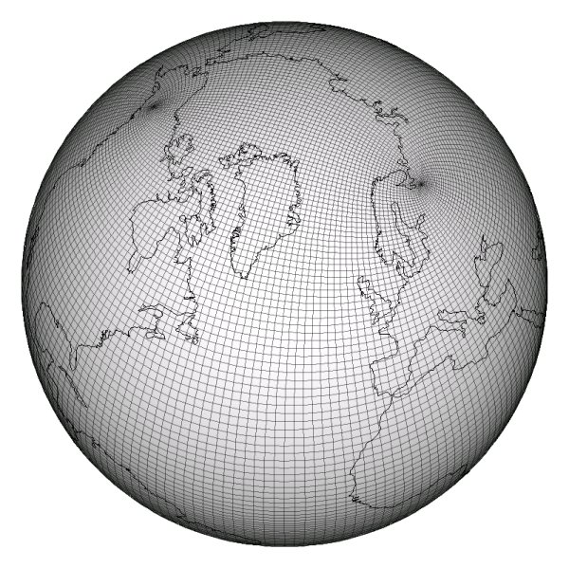

Refactoring a Climate Simulation Miniapp to use a PGAS programming model
Andy Stone
NCAR Intern, SiParCS 2010
PhD student: Colorado State University
Internship Mentor: John Dennis
PhD advisor: Michelle Strout
Andrew Stone -- 2010 NCAR SiParCS Presentation Slide 1

Slide 2








What are programming models
Parallel programming models:
  technologies to express parallel computations. (languages and libraries)
  Lots of models exist
Ct
Why use them:
Cilk
CHAPEL
Improved productivity:
  Fewer bugs
  Smaller development time
CUDA
Map-Reduce
STAPL
Andrew Stone -- 2010 NCAR SiParCS Presentation Slide 2

Slide 3
The predominance of MPI
Predominent model is MPI
"the assembly language of parallel programming"
PGAS: partitioned global address space
  No explicit message passing
  One-sided communication
  More natural way to express parallelism
Adoption of models effected by:
Need to work with existing code
Need to maintain high performance
Lack of knowledge of applicability with real-world codes
Lack of developers experienced with these models
Andrew Stone -- 2010 NCAR SiParCS Presentation Slide 3
Notes:
PGAS: "More natural way to express parallelism"

Slide 4
Studying applicability with
"Real world" codes
Ideally:
Port lots of full-scale real world codes
Study these ported implementations
Realistically:
Real world codes can be huge (a million lines in climate sims.)
Experts with the code would need to do the port or offer a huge amount of support.
This support won't come unless the benefits are evident.
But "the benefits" are what we're trying to study!
Andrew Stone -- 2010 NCAR SiParCS Presentation Slide 4

Slide 5
Studying Benchmarks
Benchmarks are small programs that perform some common type of computation.
High-performance LINPACK
NAS parallel benchmarks
HPC Challenge benchmarks
Sure, these benchmarks model different ways of number crunching but do they really test model applicability?
In many ways these benchmarks are "idealized" and the devil is in the details.
Andrew Stone -- 2010 NCAR SiParCS Presentation Slide 5

Slide 6
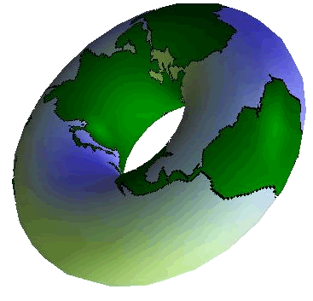
Some details
Data might not be so simple:
We don't live in donut world!
Data structures may be domain or application specific
Metadata might not be so simple:
It might not be globally replicated
Solution:
Small pieces of code (1k - 10k SLOC) extracted from real-world applications.
Miniapps!
Andrew Stone -- 2010 NCAR SiParCS Presentation Slide 6
Notes:
Explicitly mention that the earth is a sphere

Slide 7

The CGPOP Miniapp
This was created for this internship.
Conjugate gradient solver in POP
(parallel ocean program), which is part of CCSM
About 10 KLOC
Let's look at some complicating details of CGPOP
Andrew Stone -- 2010 NCAR SiParCS Presentation Slide 7

Slide 8
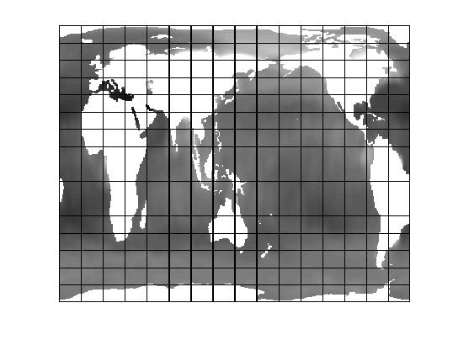
Initial CGPOP implementation
How data is stored
Two versions:
World is conceptually big 2D array
World split into blocks
Processes take ownership of blocks
Land blocks are eliminated
In 2d version:
2D array
Neighboring points stored in ghost cells
In 1d version:
1D array with indirect access
Only ocean points are stored
Neighboring points stored in halo
Andrew Stone -- 2010 NCAR SiParCS Presentation Slide 8

Slide 9
Initial CGPOP implementation
Communication to populate halo
Sender:
My Goal:
Use a PGAS language to simplify the code that does the communication step
S-buffer:
R-buffer:
Receiver:
Andrew Stone -- 2010 NCAR SiParCS Presentation Slide 9

Slide 10
Co-Array Fortran
Integrates into Cray Fortran compiler
SPMD execution (like MPI)
Co-arrays have extra dimension for processor
CAF also include some synchronization primitives
! Declaring a co-array:
integer :: A(10)[*]
! Set A(5) on right neighbor
integer :: rightNeigh = (this_image() % num_images()) +1;
A(5)[rightNeigh] = 12345
Andrew Stone -- 2010 NCAR SiParCS Presentation Slide 10

Slide 11
One-sided communication (push)
Sender:
S-buffer:
R-buffer:
Receiver:
Andrew Stone -- 2010 NCAR SiParCS Presentation Slide 11
Notes:
State that this is easy to express in PGAS

Slide 12
This should be easy right?
Not so fast! Think about what metadata is needed to do communication:
Sending proc ID
Receiving proc ID
Address to pull data from on sender
Address to place data into on receiver
Andrew Stone -- 2010 NCAR SiParCS Presentation Slide 12

Slide 13
Metadata needed for communication
With 2-sided communication:
Sender | Receiver
Receiving proc ID | Sending proc ID
Address to pull from | Address to place into
With 1-sided push communication:
With 1-sided pull communication:
Sender | Receiver
Receiving proc ID
Address to pull from
Address to place into
Sender | Receiver
 | Sending proc ID
 | Address to pull from
 | Address to place into
Andrew Stone -- 2010 NCAR SiParCS Presentation Slide 13

Slide 14
Lines of code
Original MPI version:
Init (calculate metadata): 266
Update (do communication): 33
1D pull version:
Init (calculate metadata): 33
Update (do communication): 14
Andrew Stone -- 2010 NCAR SiParCS Presentation Slide 14

Slide 15
Performance (on Lynx)
Original MPI version: 0.70 secs.
1D pull version: 36.08 secs.
Why poor performance?
Compiled to send one message per word
The compiler could help, but it doesn't
No automatic pre-fetching or message aggregation
What can be done:
Expression that access contiguous indices pass one message
A(lowIdx:highIdx)[recvProc]= B(lowIdx:highIdx)[sendProc]
Looks like we're stuck using buffers for performance.
Andrew Stone -- 2010 NCAR SiParCS Presentation Slide 15

Slide 16
Performance w/ buffers (on Lynx)
Using buffers -- performance is better but not
perfect:
Original MPI version: 0.70 secs.
Buffered push: 1.21 secs.
Buffered pull: 1.43 secs.
Andrew Stone -- 2010 NCAR SiParCS Presentation Slide 16

Slide 17
Conclusions
CAF's strong points:
  Decreased line count with non-buffered version
  Can compile with existing Fortran compiler
  Very easy learning curve
CAF's weak points:
  Immature compiler (found 2 compiler bugs)
Adoption: a chicken and egg scenario
  Immature compiler negatively impacts adoption
  Poor adoption doesn't help mature compiler
  Miniapps can help break this cycle
Lessons learned:
  Metadata placement can have a big impact on model refactorability
  Miniapp approach revealed issues
Andrew Stone -- 2010 NCAR SiParCS Presentation Slide 17

Slide 18
Conclusions
Open questions:
About my miniapp implementation:
  Refactoring vs. from scratch
  Maybe code-size / performance could be improved by changing data-layout?
  What about other models? (UPC, X10, Titanium, Chapel, etc.)
  About evaluating with miniapps:
    Better metric than SLOC?
    What to include in a miniapp
  About the future:
  How mature will compilers be?
  How much will future interconnects help?
Andrew Stone -- 2010 NCAR SiParCS Presentation Slide 18

Slide 19
[Bonus slides]
Andrew Stone -- 2010 NCAR SiParCS Presentation Slide 19

Slide 20
What is PGAS?
Parallel programming models:
  technologies to express parallel computations. (languages and libraries)
PGAS: partitioned global address space
  No explicit message passing, 1-sided communication
Why use it?
Improved productivity:
  Fewer bugs
  Frees up scientists/programmers to do other things
  Quicker time-to-solution
Andrew Stone -- 2010 NCAR SiParCS Presentation Slide 20
Notes:
PGAS: "More natural way to express parallelism"

Slide 21

Programming Models
There are many parallel programming models
MPI is predominantly used
MPI: "the assembly language of parallel programming"
Cilk
Ct
CHAPEL
STAPL
Map-Reduce
CUDA
Adoption of models effected by:
Need to work with existing code
Need to maintain high performance
Lack of knowledge of applicability with real-world codes
Lack of developers experienced with these models
Andrew Stone -- 2010 NCAR SiParCS Presentation Slide 21

Slide 22
Lines of code
Original MPI version:
Init (calculate metadata): 266
Update (do communication): 33
2D push/pull buffered version:
Init (calculate metadata): 299
Update (do communication): 24
Andrew Stone -- 2010 NCAR SiParCS Presentation Slide 22

Slide 23
One-sided communication (pull)
Sender:
Receiver:
Andrew Stone -- 2010 NCAR SiParCS Presentation Slide 23

Slide 24
Results
Some more subjective statements:
Learning curve
Thoughts on compiler
Andrew Stone -- 2010 NCAR SiParCS Presentation Slide 24

Slide 25
Results: learning curve
CAF very easy to learn
Need to be careful with off by one error
Not a lot of documentation available
Conclusion: CAF is a very learnable model given that it is a small extension to Fortran. Better debugger support would improve learnability.
Andrew Stone -- 2010 NCAR SiParCS Presentation Slide 25

Slide 26
Results: compiler difficulties
2 Compiler bugs:
Passing parameters
Optimizations with derived types
Conclusion: CAF compilers still not mature, however miniapp implementation reveals these issues
Andrew Stone -- 2010 NCAR SiParCS Presentation Slide 26

Slide 27
One parallel programming model
Can't study every model under the sun; must narrow to one:
Co-array Fortran
Benefits:
Commercial compiler (Cray)
Integrates into Fortran (don't have to rewrite entire code base)
One-sided communication (data is pushed or pulled)
Specifically looking at:
Communication step
CAF (and PGAS in general) is all about one-sided communication
Andrew Stone -- 2010 NCAR SiParCS Presentation Slide 27

Slide 28
Index spaces
Data resides in the following index spaces:
Halo indices
Receive buffer indices
GDOF indices
Andrew Stone -- 2010 NCAR SiParCS Presentation Slide 28

Slide 29
Results: SLOC 1D
SLOC calculated via sloccount tool
Original MPI version:
Init: 266
Update: 33
 | Non-buffered |  | Buffered
 | init | update | init | update
Push | -- | -- | 299 | 24
Pull | 33 | 14 | 297 | 24
Andrew Stone -- 2010 NCAR SiParCS Presentation Slide 29

Slide 30
Communication Metadata: original: receiver
Variable | Description
nRecv | Number of neighbors to receive data from
rNeigh[] | List of neighbors to receive data from (by MPI rank)
ptrRecv[] | Array of offsets in receive buffer where data received from each neighbor in rNeigh should be placed.
recvCnt[] | Number of values that should be received from each neighbor in rNeigh
recv2halo[] | Maps indices in buffer to indices in halo
Andrew Stone -- 2010 NCAR SiParCS Presentation Slide 30

Slide 31
Communication Metadata: original: sender
Variable | Description
nSend | Number of neighbors to send data to
sNeigh[] | List of neighbors to send data to (by MPI rank)
ptrSend[] | Array of offsets in send buffer where data to be send to each neighbor in sNeigh should be placed.
sendCnt[] | Number of values that should be received from each neighbor in rNeigh
halo2send[] | Maps indices in buffer to indices in halo
Andrew Stone -- 2010 NCAR SiParCS Presentation Slide 31

Slide 32
Initial CGPOP implementation
Pattern of communication
with metadata annotations
Sender:
halo2send
S-buffer:
sNeigh, ptrSend, sendCnt
rNeigh, ptrRecv, recvCnt
R-buffer:
recv2halo
Receiver:
Andrew Stone -- 2010 NCAR SiParCS Presentation Slide 32

Slide 33
Initial CGPOP implementation
It helps to understand:
Distribution of computation:
What processor does what work
Distribution of data:
What structure does data take and where is it stored
Pattern of communication
Who sends what, who recievies it, and when does communication occur
Andrew Stone -- 2010 NCAR SiParCS Presentation Slide 33

Slide 34
Initial CGPOP implementation
Distribution of computation:
Owner-computes
Andrew Stone -- 2010 NCAR SiParCS Presentation Slide 34

Slide 35
Results: SLOC 2D
SLOC calculated via sloccount tool
Original MPI version:
Init: 574
Update: 151
 | init | update
Push | 160 | 94
Pull | 160 | 94
Andrew Stone -- 2010 NCAR SiParCS Presentation Slide 35

Slide 36
Results: Performance 1D
All times are in seconds
Original MPI version: 0.70
 | Non-buffered | Buffered
Push | -- | 1.21
Pull | 36.08 | 1.43
Andrew Stone -- 2010 NCAR SiParCS Presentation Slide 36

