Slide 1


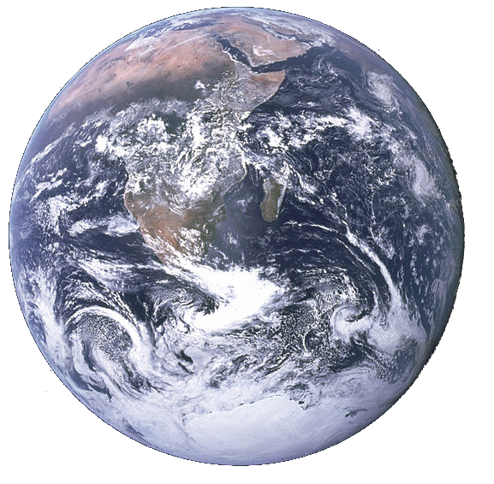
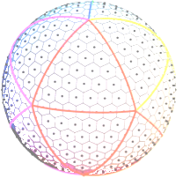
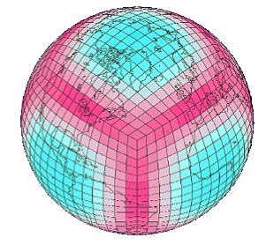
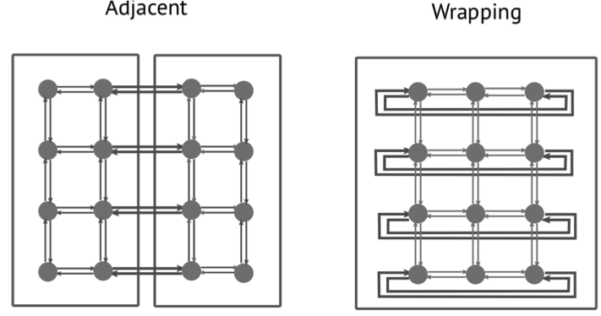
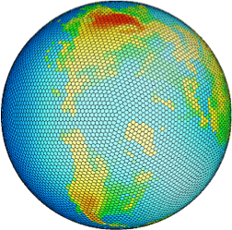
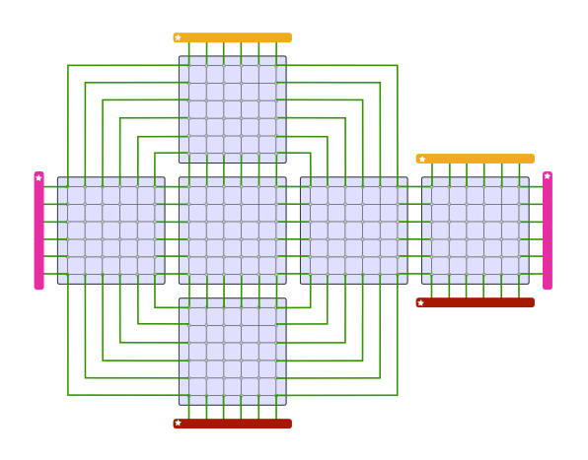
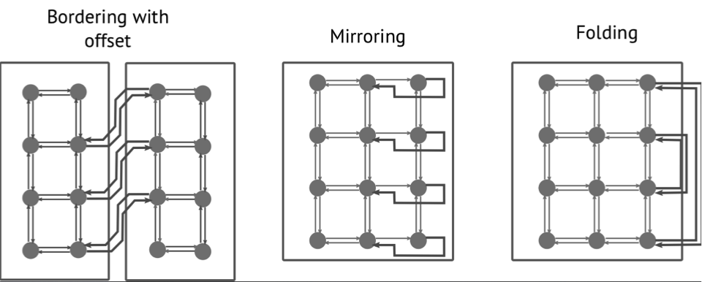
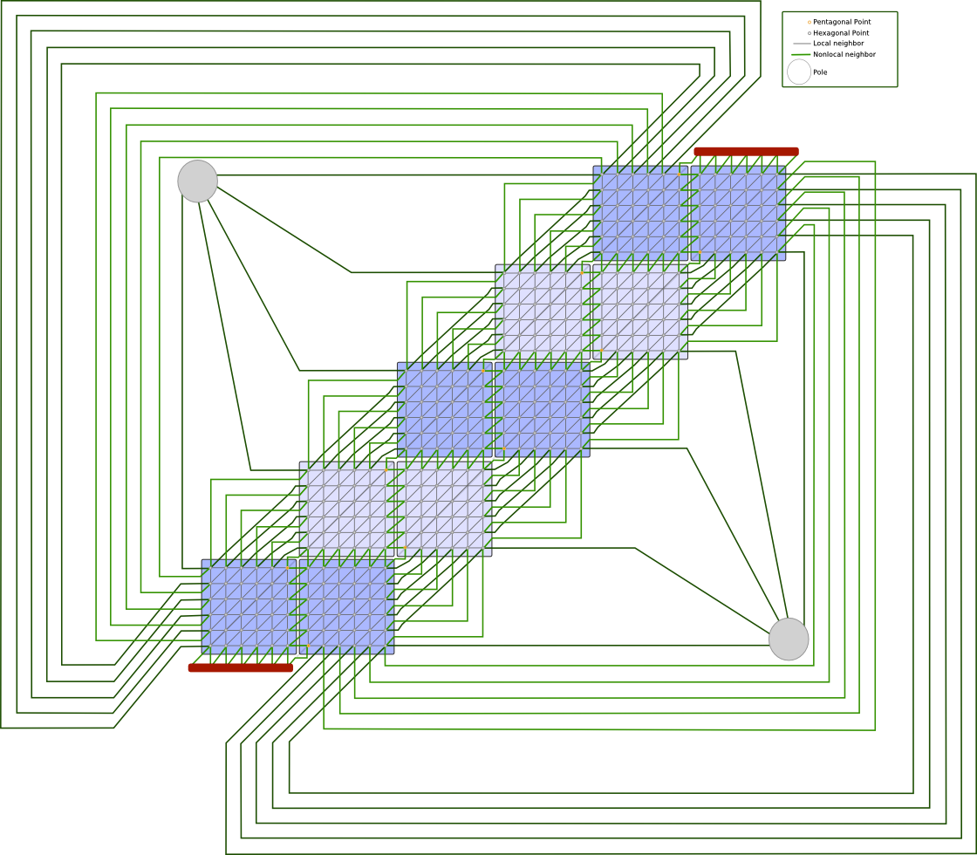
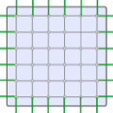
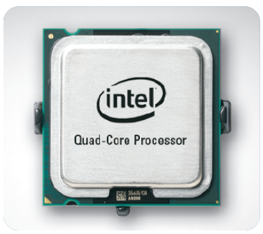
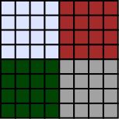
Abstractions for Defining Semi-Regular Grids
Orthogonally from Stencil Computations
Andrew Stone, Michelle Mills Strout
Motivation
Earth Grids
GridWeaver
With the GridWeaver code generator we are able to produce semi-regular grid stencil code that matches hand-written code.
BACON ISTEC CRAY
Experiments are with CGPOP stencil on a Dipole grid
Bacon is: a 16 core, 2.13 GHz, XeonE7 machine
Bacon experiments ran for 100 iterations on a 3600 x 3600 grid
The ISTEC Cray is: A Cray XT6m with 1248 cores across 52 nodes, 24 cores per node
ISTEC Cray results ran for 1000 iterations on 10800 x 10800 grid
Scientists use Earth Simulation programs to:
Predict change in the weather and climate
Gain insight into how weather and climate works
These programs work on a discretization
of the Earth (called a Grid) and apply
stencil computations.
Many Earth Simulation programs use grids that consist of sets of regular grids connected in an irregular fashion
We call this class Semi-Regular
Below we illustrate the cubed sphere and geodesic grid, and various connectivity patterns:
After data is structured into a grid it
is blocked and distributed to processors.
Input Data
Fortran Program w/ GridLib Calls
Debug path
Fortran Compiler
Program
Performance Path
GridWeaver
Optimized program
GridLib
Tangled Details
[1]
[2]
Stencil and communication code is commonly impacted by grid structure and parallelization details.
  Loop {
  communicate()
  stencil()
  }
Grid structure
Stencil
Data decomposition
Optimizations
Stencil function
5% CGPOP
1.5% SWM
Communication function
19% CGPOP
30% SWM
Communication Plans
Example Program
! Define grid
call sugrid_new(sg1, N, M)
call sugrid_new(sg2, N, M)
call grid_new(g)
call grid_placeAdjacentWE(g, sg1, sg2)
! Define distribution and read in data
call distribution_new_blocked(dist, g, 100, 100)
call data_new_from_file(data_in, “input.dat”, g, dist)
! Apply stencil
data_out = data_apply(data_in, fourPtAvg)
real function fourPtAvg(A, i, j)
fourPtAv = &
0.2 * (A(i,j) + A(i-1,j) + &
A(i+1, j) + A(i, j-1) + &
A(i, j+1))
end function
GridLib includes an algorithm to determine how to populate halo regions around blocks and subgrids.
Future Work
Non compact stencils
Implementation in SWM and CGPOP
Optimizations
[1] Picture from < http://www.scidacreview.org/0904/html/hardware1.html>
[2] Picture from <http://kiwi.atmos.colostate.edu/BUGS/geodesic/>

