Slide 1
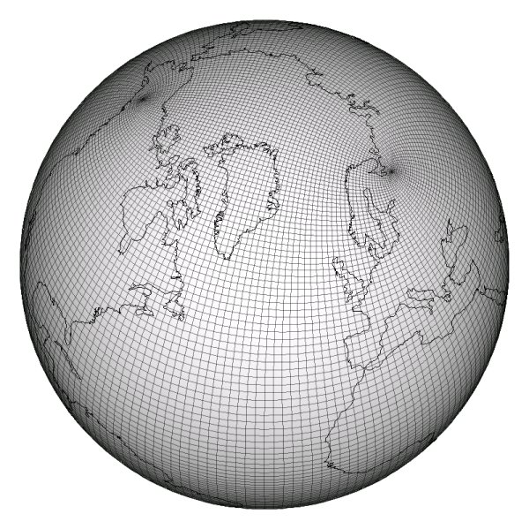
Abstractions to Separate Concerns in Semi-Regular Grid Computations
International Conference on Supercomputing
June 12, 2013
Andy Stone
Michelle Strout
Andrew Stone Slide 1

Slide 2
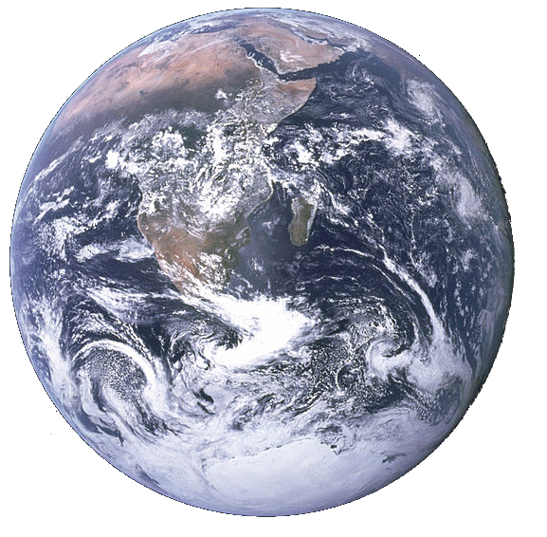
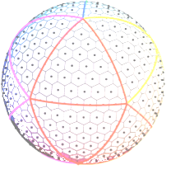
Motivation
Scientists use Earth Simulation programs to:
  Predict change in the weather and climate
  Gain insight into how the climate works
Performance is crucial: it impacts time-to-solution and accuracy
Discretize!
Apply a stencil!
Andrew Stone Slide 2

Slide 3
Problem: Implementation details tangle code
  Loop {
  communicate()
  stencil()
  }
Stencil function
5% (150 SLOC) CGPOP
25% (1770 SLOC) SWM
Grid structure
Stencil
Data decomposition
Optimizations` `
Communication function
19% (570 SLOC) CGPOP
30% (2120 SLOC) SWM
Generic stencil and communication code isn’t written due to need for performance.
Andrew Stone Slide 3
Notes:
SWM 7078 SLOC 109
SLOC 3000 SLOC 301

Slide 4
Shallow Water Model (SWM) Stencil Code
x2(:,:) = zero
DO j = 2,jm-1
DO i = 2,im-1
x2(i,j) = area_inv(i,j)* &
((x1(i+1,j )-x1(i,j))*laplacian_wghts(1,i,j)+ &
(x1(i+1,j+1)-x1(i,j))*laplacian_wghts(2,i,j)+ &
...
ENDDO
ENDDO
! NORTH POLE
i = 2; j = jm
x2(i,j) = area_inv(i,j)*laplacian_wghts(1,i,j)*((x1(i+1,j)- ...
! SOUTH POLE
i = im; j = 2
x2(i,j) = area_inv(i,j)*laplacian_wghts(1,i,j)*((x1( 1, jm)- ...
Andrew Stone Dissertation proposal Slide 4
Notes:
This pattern appears multiple times

Slide 5
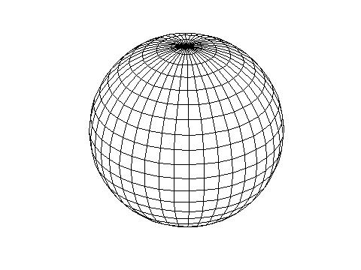
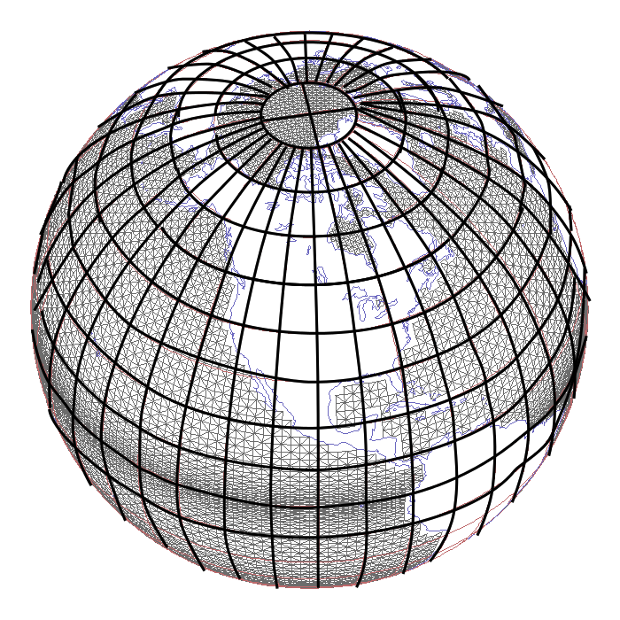
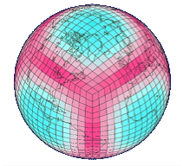
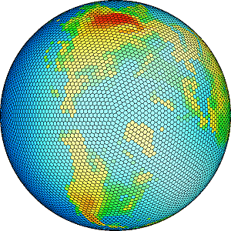
Earth Grids
CGPOP
SWM
Dipole
Tripole
Cubed Sphere
Geodesic
POP
Andrew Stone Slide 5
Notes:
This pattern appears multiple times

Slide 6
Solution
Create set of abstractions to separate details
  Subgrids, border maps, grids, distributions, communication plans, and data objects
Provide abstractions in a library (GridWeaver)
Use code generator tool to remove library overhead and optimize
Andrew Stone Slide 6

Slide 7
Talk outline
Grid connectivity
Parallelization
Planning Communication
Maintaining Performance
Conclusions
Andrew Stone Slide 7

Slide 8
Grid connectivity
Andrew Stone Slide 8

Slide 9
Grid type tradeoffs
Irregular
✔
Most general
Structured with a graph
Connectivity is explicitly stored
✗
Regular
✗
Restricted to a regular tessellation of an underlying geometry
Structured with an array
Storage efficient
i
j
✔
Andrew Stone Slide 9

Slide 10
Impact on code
Generic:
for each cell c
c = sum(neighbors(c))
Irregular
for x = 1 to n
for neigh = 1 to numNeighs(x)
A(x) += A(neighbor(x, neigh))
Regular
Structured with an array
Storage efficient
for i = 1 to n
for j = 1 to m
A(i,j) = A(i-1, j) + A(i+1, j) +
A(i, j-1) + A(i, j+1)
i
j
Andrew Stone Slide 10

Slide 11
Impact of indirect access
int direct() {
int sum = 0;
for(int i = 0;
i < DATA_SIZE; i++)
{
sum += A[i];
}
return sum;
}
int indirect() {
int sum = 0;
for(int i = 0;
i < DATA_SIZE; i++)
{
sum += A[B[i]];
}
return sum;
}
3.47 secs
38.41 secs
with DATA_SIZE = 500,000,000 (approx. 1.8 GB)
2.3 GHz Core2Quad machine with 4GB memory
Andrew Stone Slide 11

Slide 12
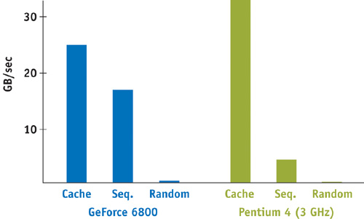
Penalty for Irregular Accesses
Source: Ian Buck, Nvidia

Slide 13
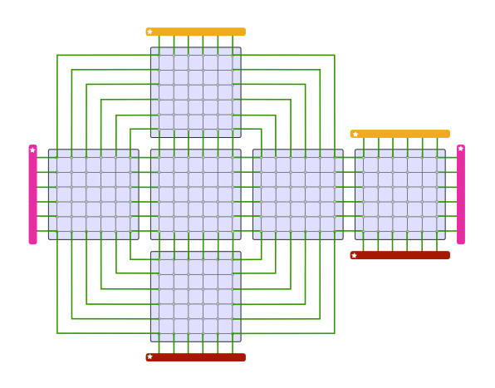
Many Earth grids are not purely regular
This is the structure of the cubed-sphere grid
Set of regular grids (arrays)
Connected to one another in an irregular fashion
Specialized communication code is needed to handle the irregular structure.
Andrew Stone Slide 13

Slide 14
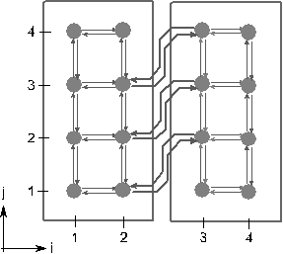
Subgrids and grids
type(subgrid) :: sgA, sgB
type(Grid) :: g
sgA = subgrid_new(2, 4)
sgB = subgrid_new(2, 4)
g = grid_new()
call grid_addSubgrid(sgA)
call grid_addSubgrid(sgB)
sgA
sgB
Andrew Stone Slide 14

Slide 15
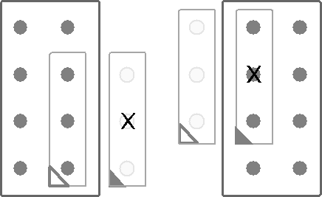
Border Mappings
sgA
sgB
call grid_addBorderMap(3,1, 3,3, sgA,
1,2, 1,4, sgB)
call grid_addBorderMap(0,2, 0,4, sgB,
2,1, 2,3, sgA)
Andrew Stone Slide 15

Slide 16
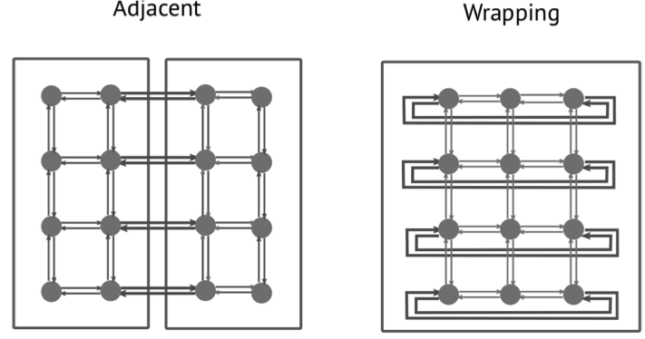
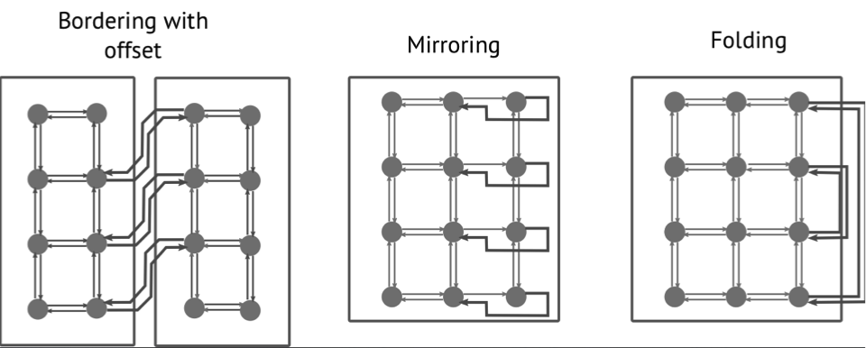

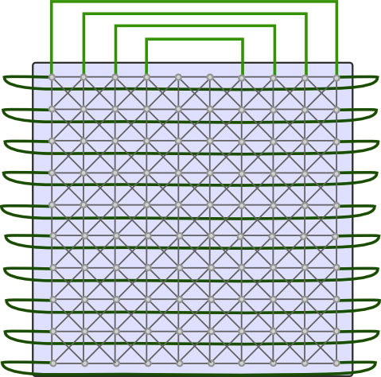
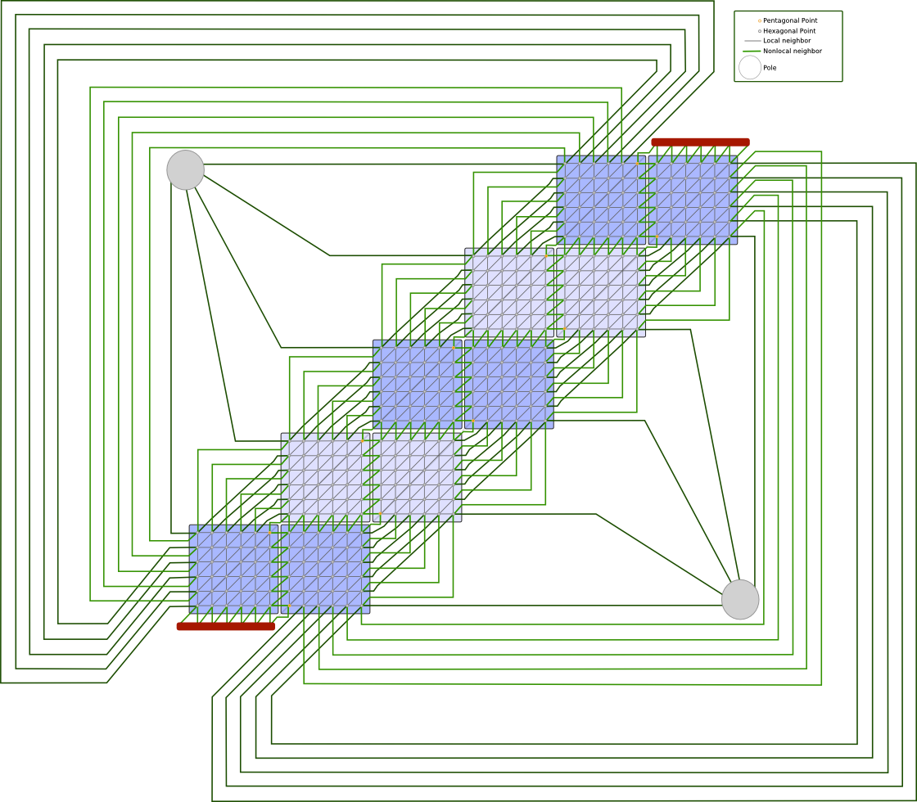
Connectivity between subgrids
Dipole:
Wrapping
Cubed Sphere:
Adjacent
Tripole:
Wrapping, folding
Icosahedral:
Adjacent, offset
Andrew Stone Slide 16

Slide 17
Parallelization
Andrew Stone Slide 17

Slide 18
Domain decomposition for parallelization
How to map data and computation onto processors?
Andrew Stone Slide 18

Slide 19
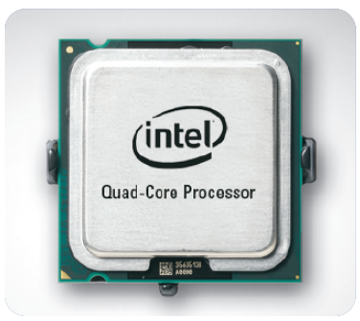
Domain decomposition for parallelization
How to map data and computation onto processors?
Andrew Stone Slide 19

Slide 20

Domain decomposition for parallelization
How to map data and computation onto processors?
Andrew Stone Slide 20

Slide 21
Domain decomposition for parallelization
How to map data and computation onto processors?
Andrew Stone Slide 21

Slide 22
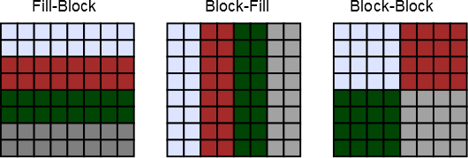
Distributions
Example:
call grid_distributeFillBlock(g, 2)
Andrew Stone Slide 22

Slide 23
Planning communication
Andrew Stone Slide 23

Slide 24
Halos around blocks
Andrew Stone Slide 24
Notes:
Talk about transfer aggregation

Slide 25
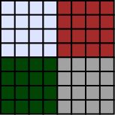
Communication plan abstraction
int nMsgsRecv
int* msgRecvFrom // msgID -> pid
int* mTransferRecvAtLBID // msgID, tid -> lbid
Region** mTransferRegionRecv // msgID, tid -> rgn
// Analogous structures exist for sending side
Andrew Stone Slide 25

Slide 26
Problems with Performance
Andrew Stone Slide 26

Slide 27
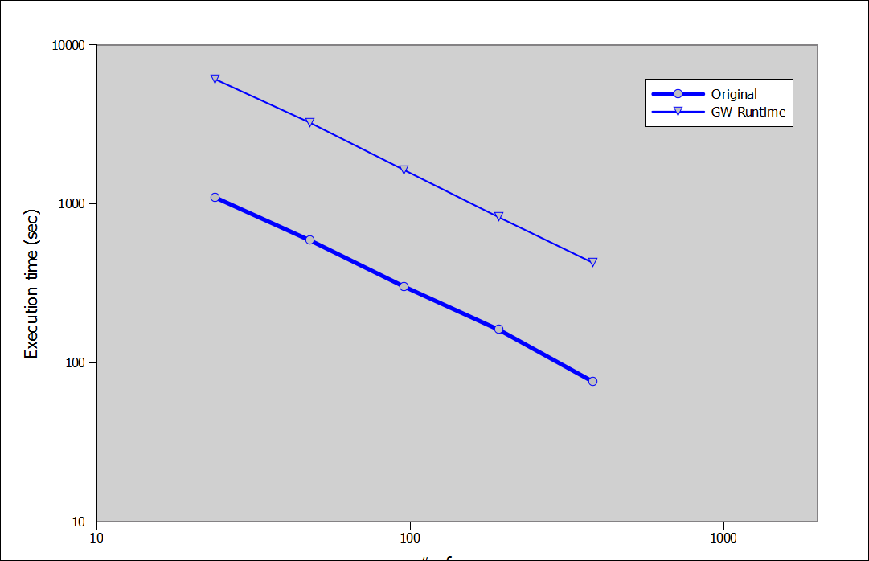
Impact of code generation
Implementation of stencil from CGPOP on a dipole grid
Goal: To Have GridGen match performance of handwritten code
6,058 s
1,093 s
424 s
72.9 s
Cray XT6m with 1248 cores across 52 compute nodes,
24 cores per compute node
2260 iterations on a10800 x 10800 grid
Andrew Stone Slide 27

Slide 28
Cause of overhead
STENCIL(fivePt, A, i, j)
fivePt = 0.2 * &
(A(i, j) + A(i-1, j) + &
A(i+1, j) + A(i, j-1) + A(i, j+1))
end function
Andrew Stone Slide 28

Slide 29
Cause of overhead
Called once per
grid node
function fivePt(A, i, j)
integer, intent(in) :: i, j
interface
integer function A(x,y)
integer, intent(in) :: x,y
end function
end interface
fivePt = 0.2 * &
(A(i, j) + A(i-1, j) + &
A(i+1, j) + A(i, j-1) + A(i, j+1))
end function
Imposters of arrays
Andrew Stone Slide 29

Slide 30
Code generation tool
Input Data
Fortran Compiler
Debug Path
Program
Fortran Program w/ GridWeaver Calls
GridWeaver
Performance path
Optimized program
Runtime lib
Andrew Stone Slide 30

Slide 31
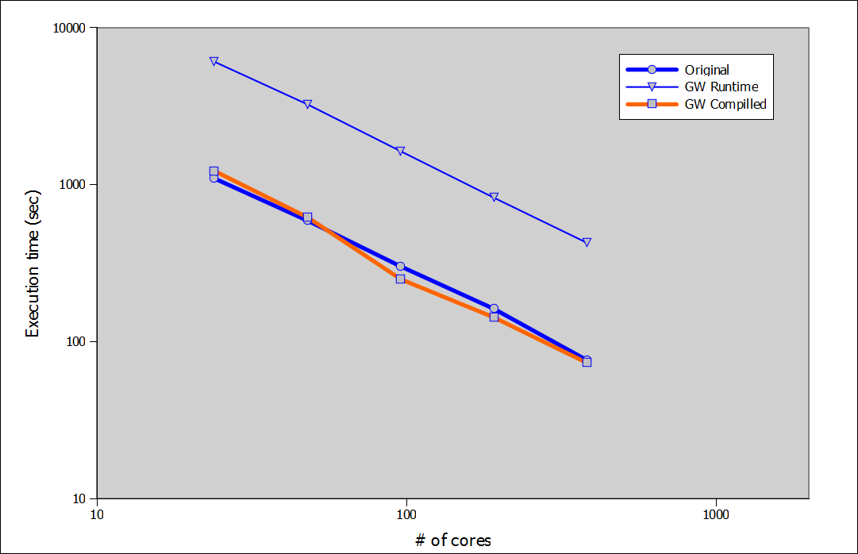
Impact of code generation
Implementation of stencil from CGPOP on a dipole grid
Goal: To Have GridGen match performance of handwritten code
6,058 s
1,220 s
1,093 s
1,093 s
424 s
75 s
75 s
73 s
Cray XT6m with 1248 cores across 52 compute nodes,
24 cores per compute node
2260 iterations on a10800 x 10800 grid
Andrew Stone Slide 31

Slide 32
Conclusions
Andrew Stone Slide 32

Slide 33
Talk Summary
Project goal:
To enable a separation of concerns for semiregular grid computations between stencil algorithm and grid structure and parallelization and decomposition details.
Approach:
Implementing grid, subgrid, border-mapping, distribution abstractions and automatically generating communication schedules to populate halos
Project goal:
Match performance of existing semi-regular stencil computations.
Approach:
Use code generator to inline library calls.
Andrew Stone Slide 33

