Slide 1
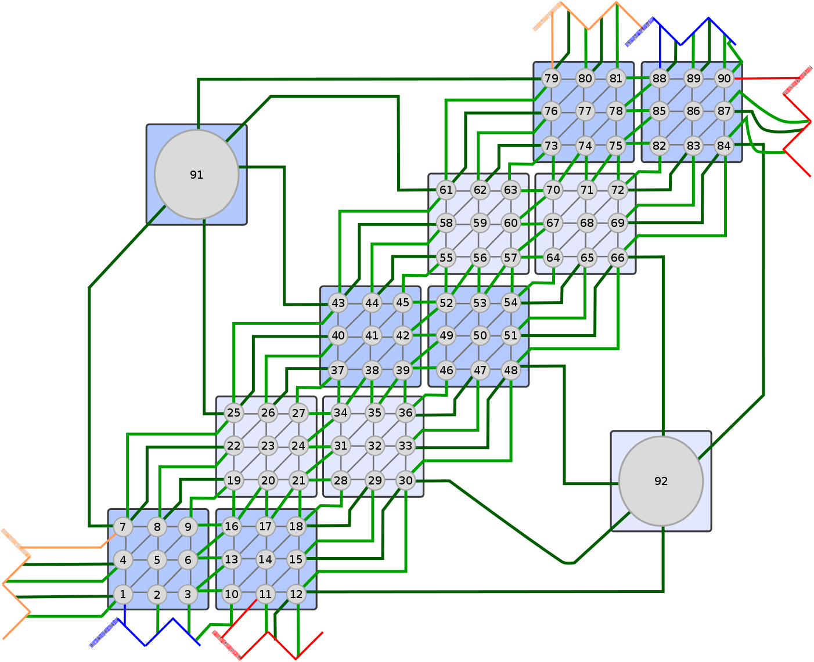
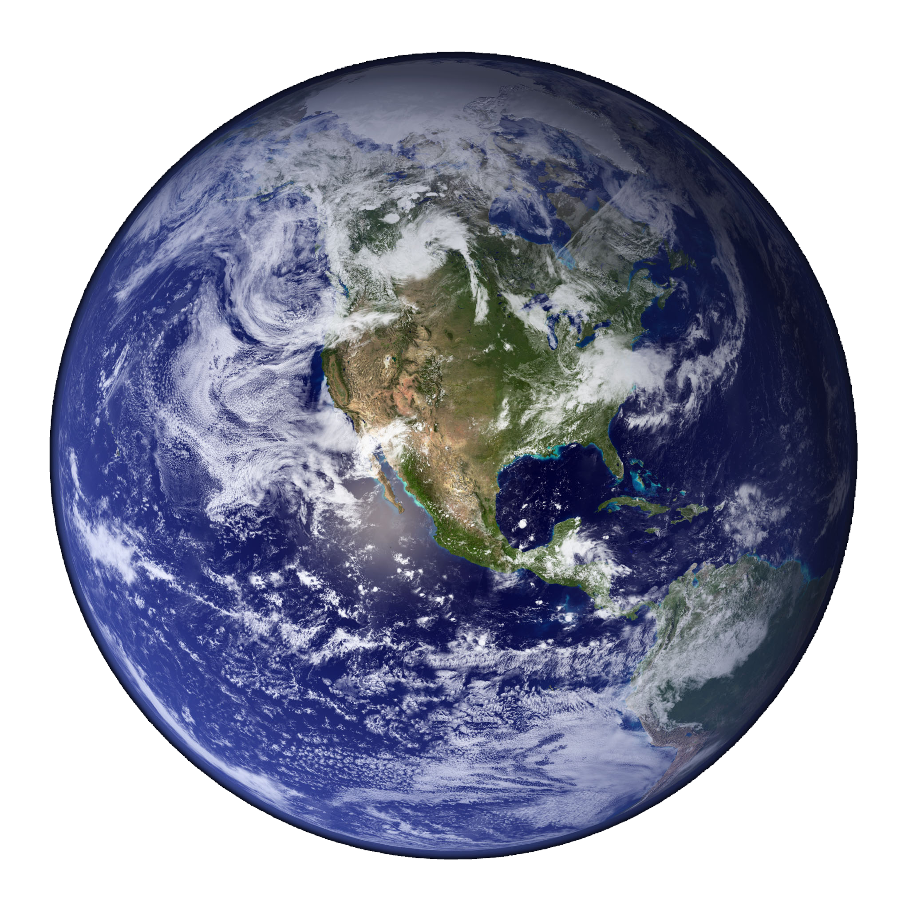

Separating Implementation Concerns in Semiregular Grids for Stencil Computations
Andy Stone
July 2nd, 2013
PhD Defense
Andrew Stone PhD Defense Slide 1

Slide 2
Introduction
Goal: to improve programmability and maintainability of Earth simulation applications.
Importance: scientists use these applications to:
  Predict change in the weather and climate.
  Gain insight into how the climate works.
The more time spent developing and maintaining an application, the less time remains to actually use it.
Approach: Develop a new programming model and library called GridWeaver.
Case studies: Modify the code of two proxy applications to use GridWeaver.
  Proxy applications are smaller models of important portions of larger applications.
  CGPOP: Proxy of POP (an ocean simulation code).
  SWM: Proxy of GCRM (a cloud resolution model).
Andrew Stone PhD Defense Slide 2

Slide 3
Background:
How do Earth simulation applications work and what affects their programmability and modifiability?
Andrew Stone PhD Defense Slide 3

Slide 4
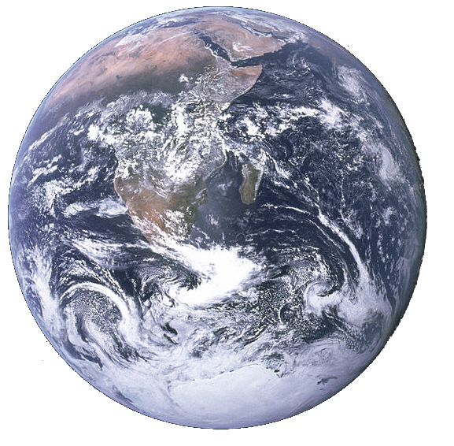
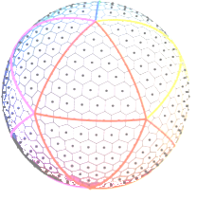
From a computer science perspective: what do Earth Simulation applications do?
They solve PDE’s on semiregular grids with stencil computations.
Andrew Stone PhD Defense Slide 4

Slide 5
Grid connectivity affects programmability
DO j = 2,jm-1
DO i = 2,im-1
x2(i,j) = area_inv(i,j) *
((x1(i+1,j)-x1(i,j))*laplacian_wghts(1,i,j.nsd) +
(x1(i+1,j+1)-x1(i,j))*laplacian_wghts(2,i,j,nsd) +
...
ENDDO
ENDDO
! NORTH POLE
i = 2; j = jm
x2(i,j) = area_inv(i,j)*laplacian_wghts(1,i,j)*((x1(i+1,j)- ...
! SOUTH POLE
i = im; j = 2
x2(i,j) = area_inv(i,j)*laplacian_wghts(1,i,j)*((x1( 1, jm)- ...
Iterate through nodes in subdomain
Apply stencil
Update north pole
Update south pole
Andrew Stone PhD Defense Slide 5
Notes:
This pattern appears multiple times

Slide 6
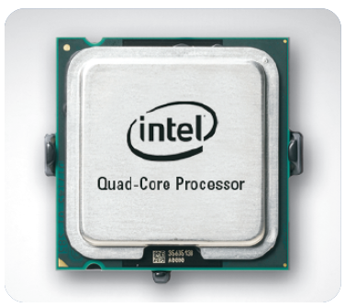
Parallelism affects programmability
Performance is crucial:
  If simulating a hurricane we need a result in real-time
  If studying climate change we want to do more computation for accuracy
Andrew Stone PhD Defense Slide 6
Notes:
This pattern appears multiple times

Slide 7
Tangled Specifications affect programmability
  initialization()
  Loop {
  communicate()
  stencil()
  }
Grid structure
Data decomposition
Stencil
Performance
Optimizations
5% (150 SLOC) CGPOP
12% (1770 SLOC) SWM
Stencil function
Communication function
38% (1226 SLOC) CGPOP
6.8% (1010 SLOC) SWM
Are modifications actually made: POP grid changed between versions 1.4.3 and 2.0.
Andrew Stone PhD Defense Slide 7
Notes:
SWM 7078 SLOC 109
SLOC 3000 SLOC 301

Slide 8
Approach for improving programmability
Fortran program w/ GridWeaver Calls
Fortran Compiler
Executable
Program
Links to
GridWeaver library
Since GridWeaver is a library users can integrate it into existing programs or write new programs from scratch.
Andrew Stone PhD Defense Slide 8

Slide 9
Approach for improving programmability
Punchline: Separates concerns and automates communication
Structure of a GridWeaver program:
Communication function provided by GridWeaver.
Instead of writing 1226 lines of code for CGPOP and 1010 lines of code for SWM, with GridWeaver users write 0 lines of code.
  - Grid connectivity spec
  - Decomposition spec
  - Initialize data
  loop {
  communicate()
  stencil()
  }
Simple stencil function:
STENCIL(swmStencil, x2, x1, area_inv, laplacian_wghts, i, j)
x2(i,j) = area_inv(i,j) *
((x1(i+1,j) - x1(i,j)) * laplacian_wghts(1,i,j) +
(x1(i+1,j+1) - x1(i,j)) * laplacian_wghts(2,i,j) +
end function
Andrew Stone PhD Defense Slide 9

Slide 10
Thesis Contributions
In today’s talk: New programming model for semiregular grids
  GridWeaver active library (library + source-to-source translator tool).
  Abstractions: grid connectivity, decomposition, stencil computation.
  Communication plan generation algorithms.
  Case studies that evaluate expressibility, performance, and programmability of GridWeaver.
In thesis: Methodology for evaluating programming models
  Terminology for comparing programming models.
  Development of CGPOP as proxy application of POP.
Andrew Stone PhD Defense Slide 10

Slide 11
Outline
Related Work
Grid Connectivity
Data\Computation Distribution
Stencil Computations
Communication
Conclusions
P Publication Record
Experimental results in sections where relevant.
Case studies:
SWM
CGPOP
Evaluation criteria:
Programmability
Expressivity
Performance
Andrew Stone PhD Defense Slide 11

Slide 12
Outline
Related Work
Grid Connectivity
Data\Computation Distribution
Stencil Computations
Communication
Conclusions
Publication Record
Andrew Stone PhD Defense Slide 12

Slide 13
Programming model approaches
Programming models are conceptual frameworks that enable programmers to describe and reason about computation.
Broader term than programming language because language implies a particular syntax.
Several different models exist for stencil computations on parallel architectures.
Distributed memory
clusters
Shared memory,
multicore systems
Overture
Pochoir
Chombo
Autotuning framework by Kamil et al.
MPAS
Cactus framework
GridWeaver
OP2
Liszt
Patus
Physis
GPUs
Mint
Andrew Stone PhD Defense Slide 13
Notes:
PGAS: "More natural way to express parallelism"

Slide 14

What makes GridWeaver unique?
We can describe and compare models by identifying how they address an application’s implementation concerns.
Implementation concerns in stencil computations:
Grid connectivity
Data structure for grid values
Data distribution
Computation distribution
Stencil computation
Iteration order
Communication
Andrew Stone PhD Defense Slide 14

Slide 15
Outline
Programming Models
Grid Connectivity
Data\Computation Distribution
Stencil Computations
Communication
Conclusions
Publication Record
Andrew Stone PhD Defense Slide 15

Slide 16
Grid type tradeoffs
Irregular
✔
Most general.
Structured with a graph.
Connectivity is explicitly stored.
Neighbors accessed indirectly through adjacency list.
✗
✗
Regular
✗
Restricted to a regular tessellation of an underlying geometry.
Structured with an array.
Storage efficient.
Neighbors accessed directly in array.
i
✔
j
✔
Andrew Stone PhD Defense Slide 16

Slide 17
Performance impact of indirect access
int direct() {
int sum = 0;
for(int i = 0;
i < DATA_SIZE; i++)
{
sum += A[i];
}
return sum;
}
int indirect() {
int sum = 0;
for(int i = 0;
i < DATA_SIZE; i++)
{
sum += A[B[i]];
}
return sum;
}
3.47 secs
38.41 secs
with DATA_SIZE = 500,000,000 (approx. 1.8 GB)
2.3 GHz Core2Quad machine with 4GB memory
Andrew Stone PhD Defense Slide 17

Slide 18
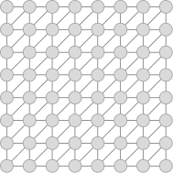
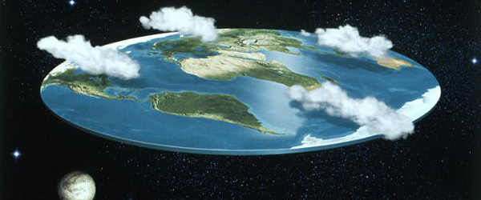
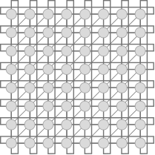
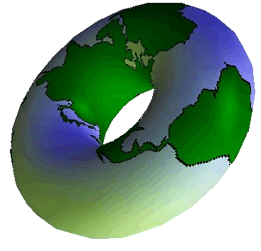
Flexible connectivity matters in Earth Grids
Andrew Stone PhD Defense Slide 18

Slide 19
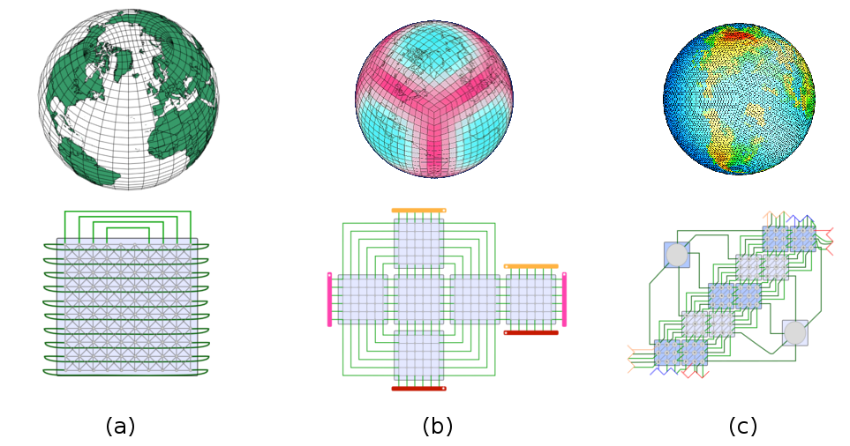
Semiregular Earth grids
Tripole
Cubed sphere
Icosahedral
Andrew Stone PhD Defense Slide 19
Notes:
This pattern appears multiple times

Slide 20
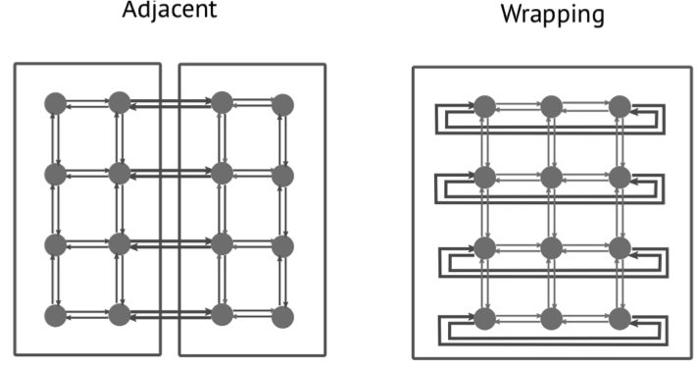
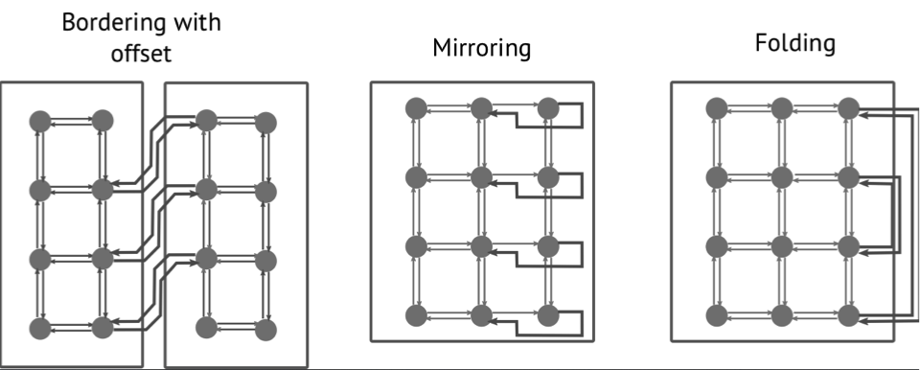

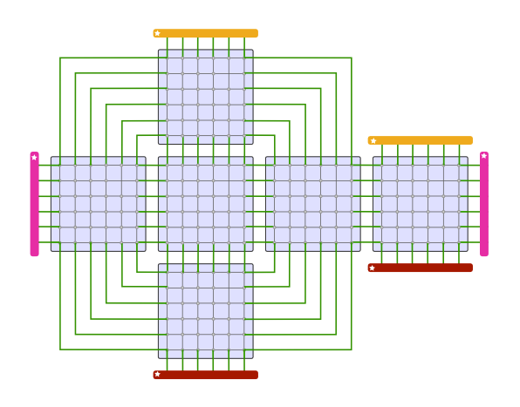
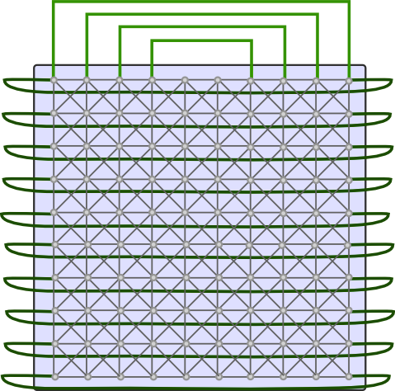
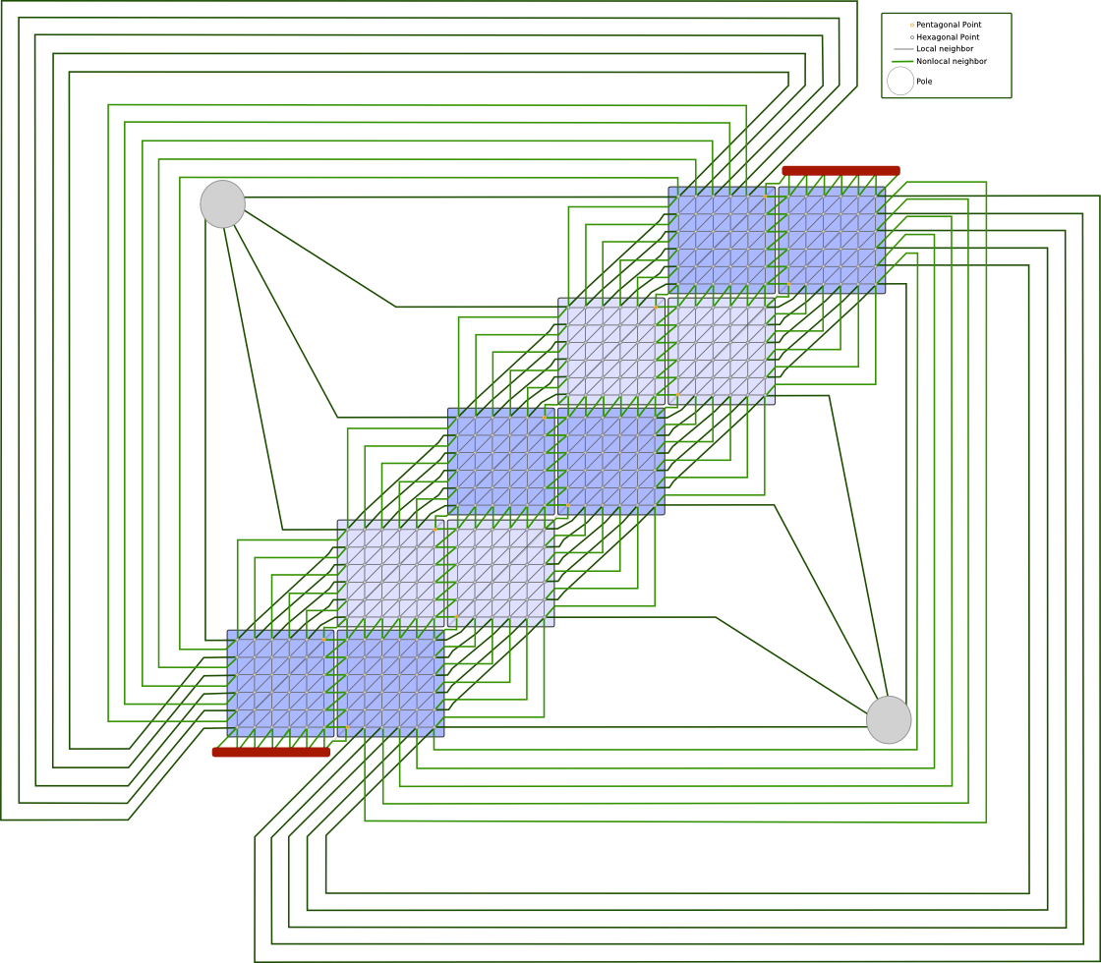
Grid connectivity patterns
Dipole:
Wrapping
Cubed Sphere:
Adjacent
Tripole:
Wrapping, folding
Icosahedral:
Adjacent, offset
Andrew Stone PhD Defense Slide 20

Slide 21
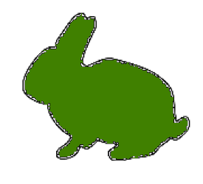
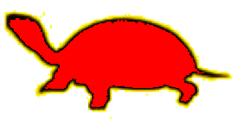
Related work: Grid structure
Expressivity: related work
Arrays
Graphs
Wrapping
Mirroring
Adjacent
Offset
Folding
ZPL’s regions (‘98) | ✔ |  | ✔ | ✔
Kamil et. al (‘09) | ✔ |  | ✔
Mint (‘11) | ✔ |  | ✔
Patus (‘11) | ✔ |  | ✔
Physis (‘11) | ✔ |  | ✔
Pocohir (‘11) | ✔ |  | ✔
OP2 (‘10) |  | ✔ | ✔ | ✔ | ✔ | ✔ | ✔
Liszt (‘11) |  | ✔ | ✔ | ✔ | ✔ | ✔ | ✔
Chombo (’09) | ✔ |  | ✔ | ✔ | ✔ | ✔ | ✔
GridWeaver | ✔ |  | ✔ | ✔ | ✔ | ✔ | ✔
Andrew Stone PhD Defense Slide 21

Slide 22
Related work: Grid structure
Expressing semiregular-grid connectivity
Current approach (in SWM and CGPOP):
  Connectivity is not expressed at a high level its hard-coded in communication routines.
Chombo’s approach:
  Connectivity specified by providing equations that map between a 3-dimensional, real, domain and a 2-dimensional, integer, mapped space.
  Chombo is a library for performing computations on adaptively refined meshes.
My approach:
  I have developed an abstraction called a border map.
Andrew Stone PhD Defense Slide 22

Slide 23
Border maps
Source
Target
call grid_addBorderMap(3,1, 3,3, sgA,
1,2, 1,4, sgB)
call grid_addBorderMap(0,2, 0,4, sgB,
2,1, 2,3, sgA)
call grid_addBorderMap(3,1, 3,3, sgA,
1,2, 1,4, sgB)
call grid_addBorderMap(0,2, 0,4, sgB,
2,1, 2,3, sgA)
Andrew Stone PhD Defense Slide 23

Slide 24
Border maps
Target
Source
call grid_addBorderMap(3,1, 3,3, sgA,
1,2, 1,4, sgB)
call grid_addBorderMap(0,2, 0,4, sgB,
2,1, 2,3, sgA)
Andrew Stone PhD Defense Slide 24

Slide 25
Evaluating how GridWeaver addresses grid connectivity
Expressivity:
  Able to express semiregular grids with border-map abstraction.
Performance:
  Data is stored in arrays.
Programmability:
  We enable a separated specification of connectivity.
  Programmers do not have to write any communication code.
Andrew Stone PhD Defense Slide 25

Slide 26
Outline
Related Work
Grid Connectivity
Data\Computation Distribution
Stencil Computations
Communication
Conclusions
Publication History
Andrew Stone PhD Defense Slide 26

Slide 27

Decomposition and distribution
How to map data and computation onto processors?
Andrew Stone PhD Defense Slide 27

Slide 28
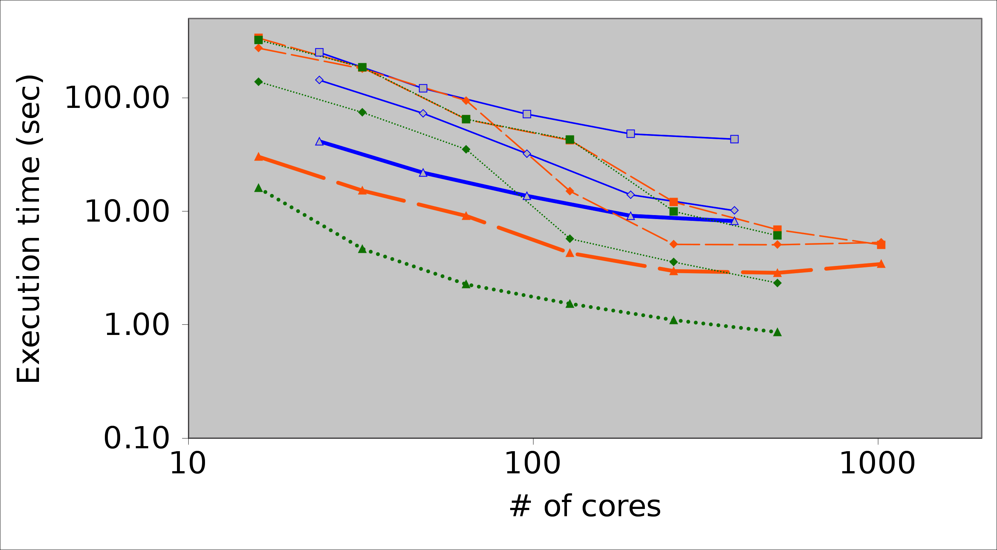
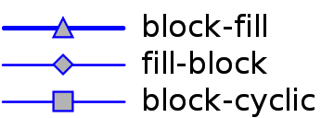
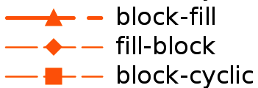
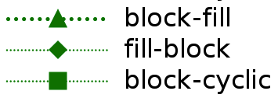
Why give users control over distribution?
Time to conduct 10,000 communication calls
on different machines with different distributions
ISTeC Cray
Yellowstone
Gordon
Performance is highly dependent on the distribution used.
Therefore its important that GridWeaver be able to run on the machines used for real-world codes and use the same types of distributions seen in real-world codes.
Andrew Stone PhD Defense Slide 28

Slide 29
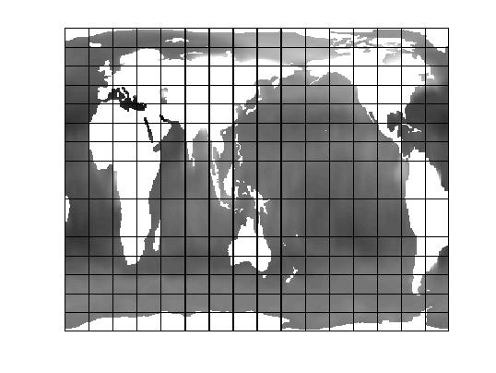
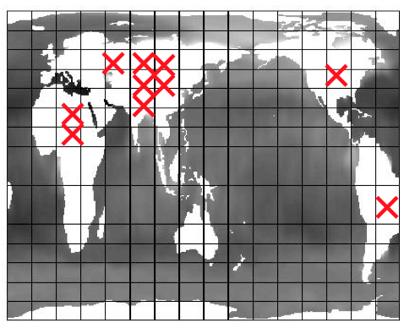
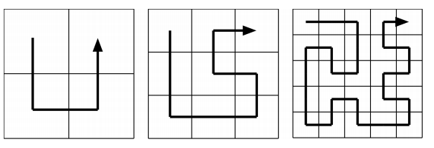
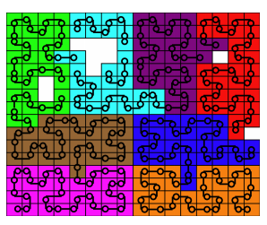
An example distribution: POP’s space filling curve
Remove land blocks
Space filling curve
Pictures from: John M. Dennis, "Inverse Space-Filling Curve Partitioning of a GlobalOcean Model," Parallel and Distributed Processing Symposium, International, p. 25, 2007 IEEE International Parallel and Distributed Processing Symposium, 2007
Andrew Stone PhD Defense Slide 29

Slide 30
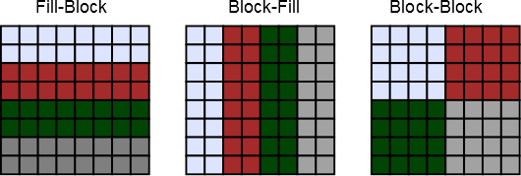
Decomposition and distribution
Example:
call grid_distributeFillBlock(g, 2)
Andrew Stone PhD Defense Slide 30

Slide 31
Evaluating how GridWeaver addresses data/computation distribution
Expressivity
  Computation distribution
    Always owner-computes.
  Data distribution
    Single function call for common distributions.
    Users can explicitly specify mapping for less common / more complicated distributions..
    We are able to express CGPOP’s and SWM’s distributions.
Performance
  Affected by distribution; so it is important that we use distributions seen in real-world codes.
Programmability
  This is the only portion where users have to think about parallelism.
  Users write no communication code.
Andrew Stone PhD Defense Slide 31

Slide 32
Outline
Related Work
Grid Connectivity
Data\Computation Distribution
Stencil Computations
Communication
Conclusions
P Publication Record
Andrew Stone PhD Defense Slide 32

Slide 33
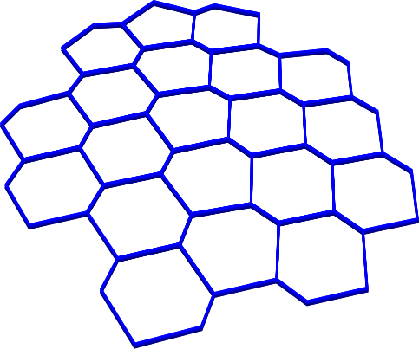
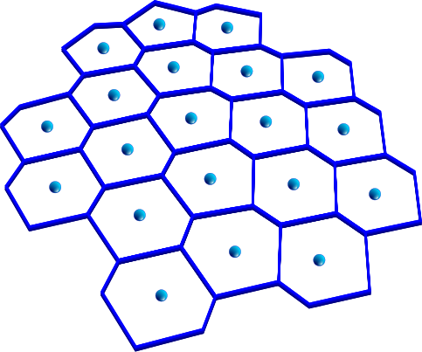
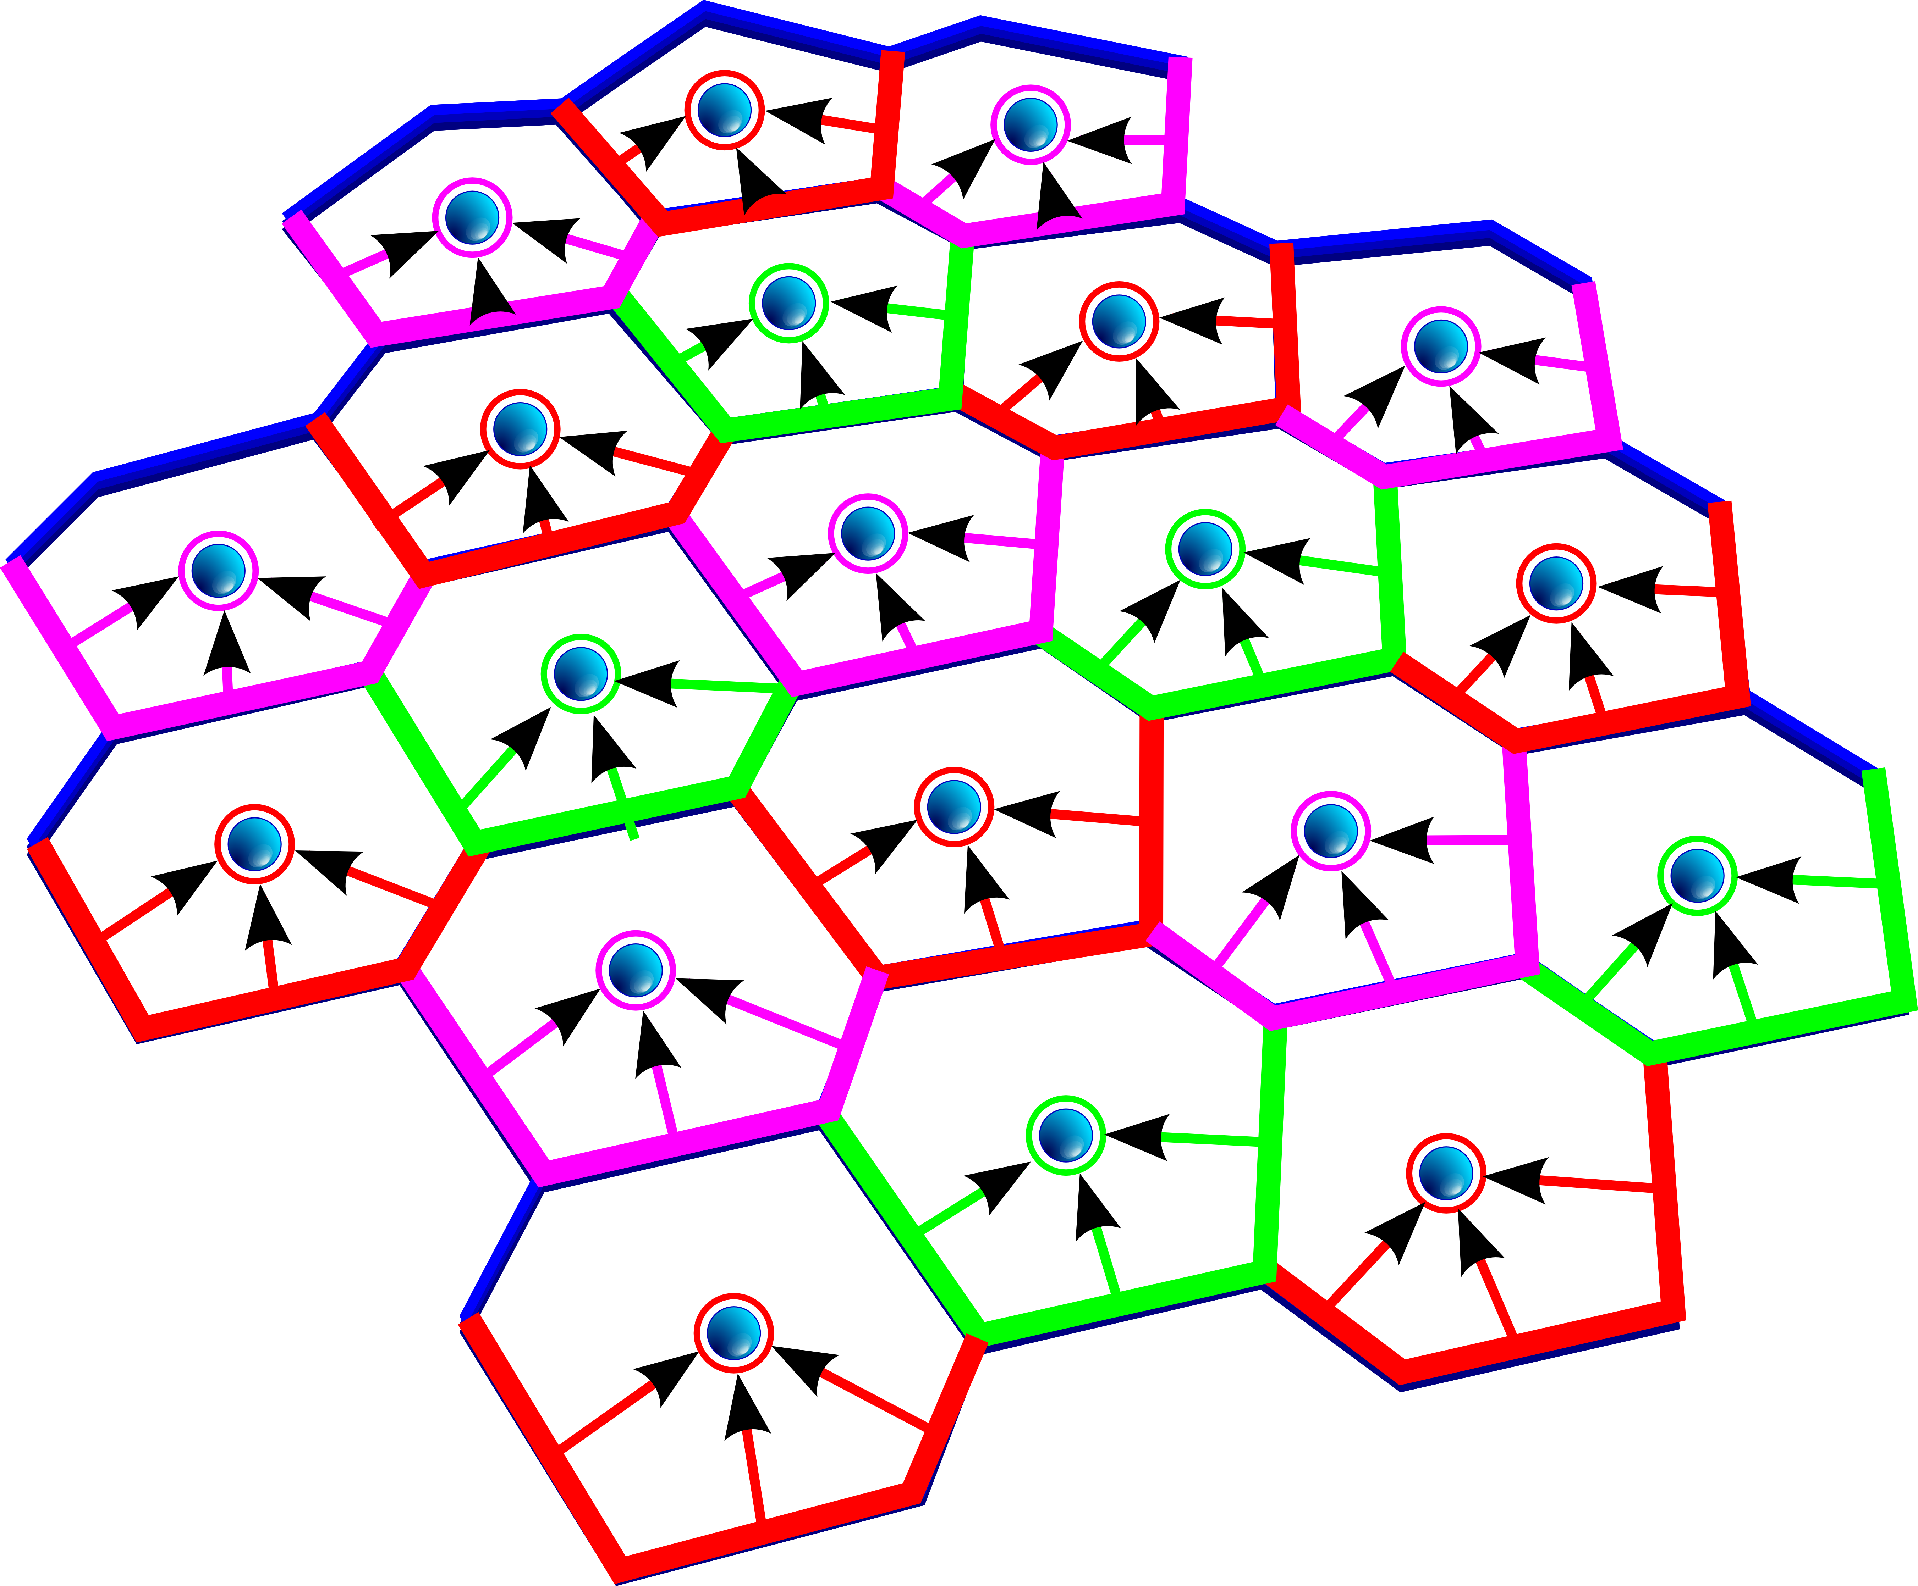
SWM Interpolation point
Compact stencil: Access nearest neighbors.
Non-compact stencil: Values further away.
Stencils in SWM:
SWM uses a compact stencil to update cell values using flux on edges.
SWM uses a non-compact stencil to update edge values.
We associate three edge values with each cell.
Andrew Stone PhD Defense Slide 33

Slide 34

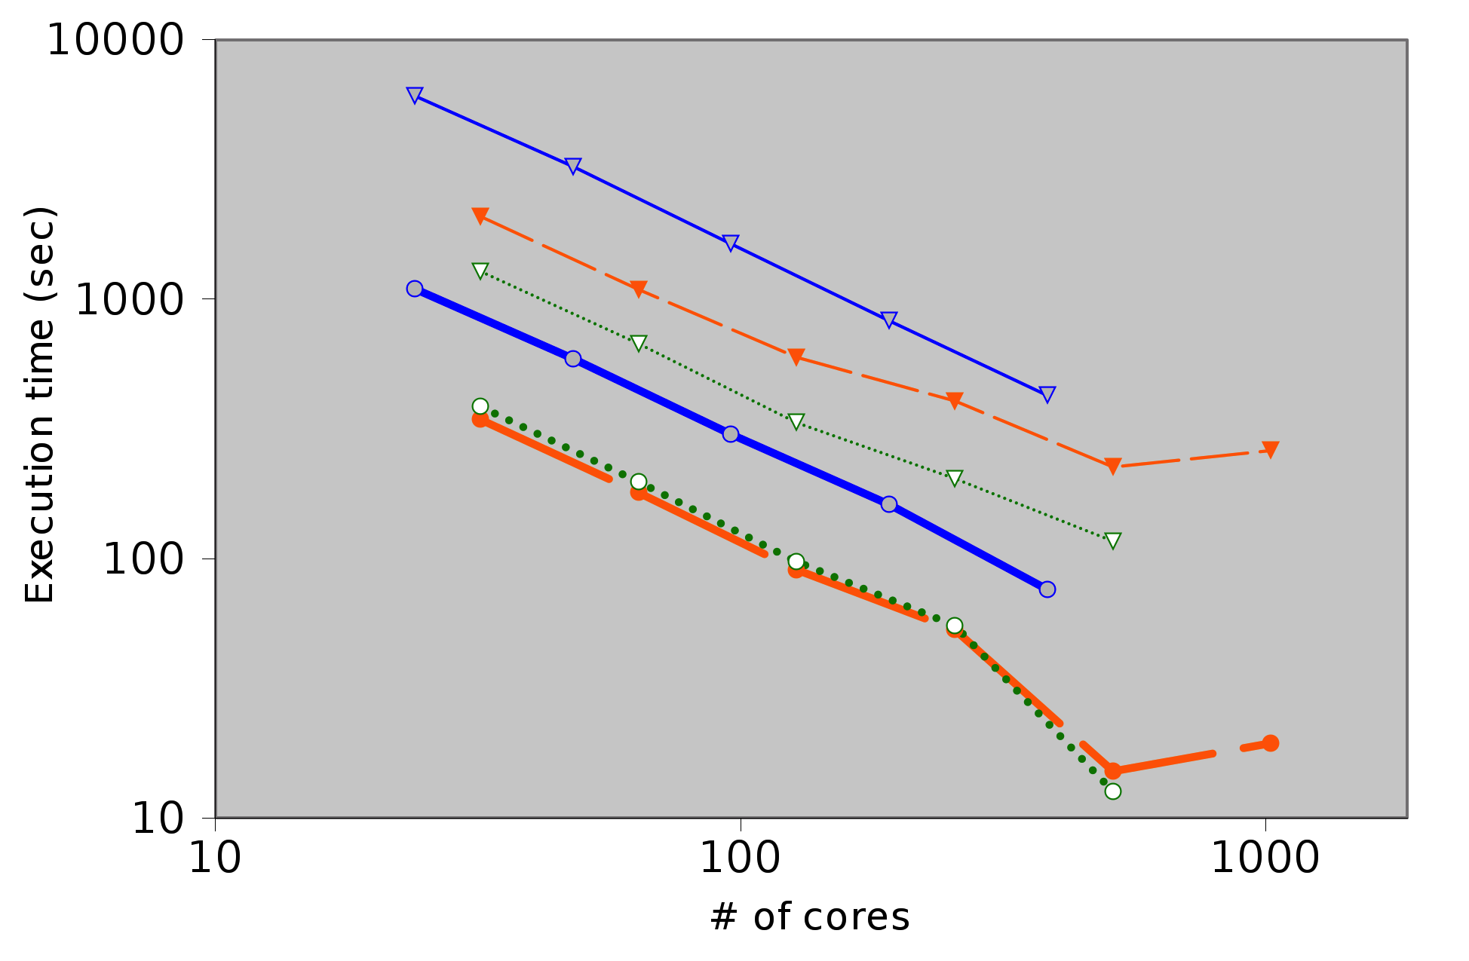
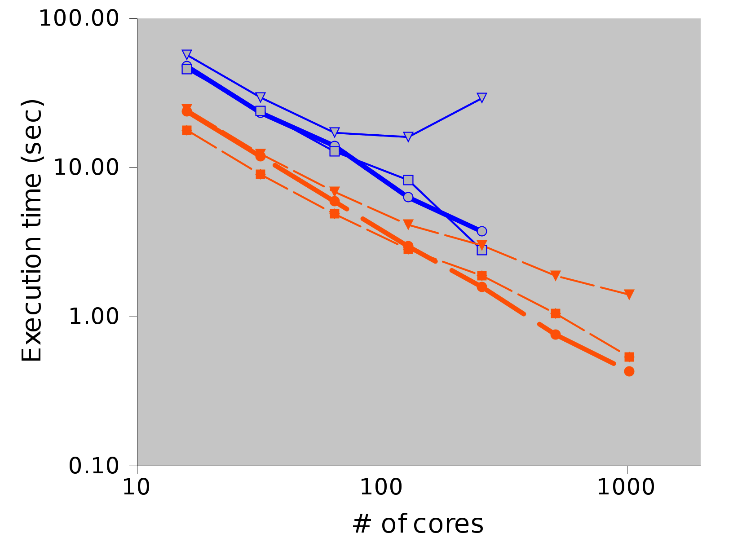
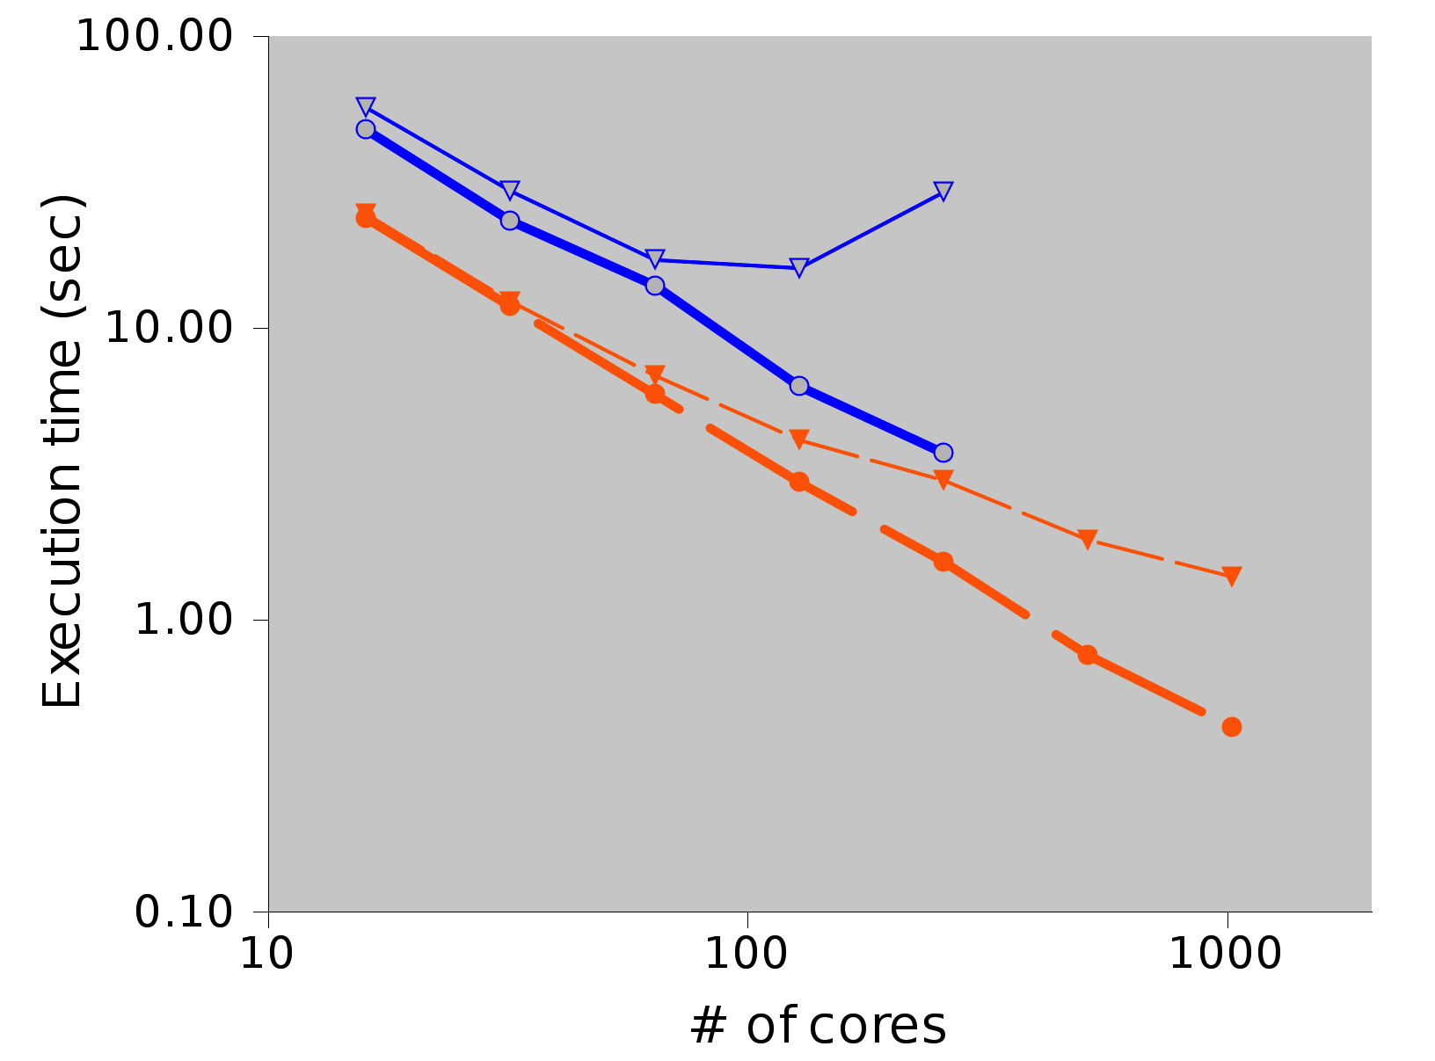


Performance
CGPOP
SWM
ISTeC Cray
Yellowstone
Gordon
Libraries have the advantage of being able to operate with existing code and debugging tools,
but they introduce library overhead.
Andrew Stone PhD Defense Slide 34

Slide 35
Cause of overhead
The GridWeaver library introduces overhead every time it calls a function.
GridWeaver calls a function:
  Each time it iterates over a cell (stencil function).
  Every time the stencil references a node (access function).
function fivePt(A, i, j)
integer, intent(in) :: i, j
interface
integer function A(x,y)
integer, intent(in) :: x,y
end function
end interface
fivePt = 0.2 *
(A(i, j) + A(i-1, j) +
A(i+1, j) + A(i, j-1) + A(i, j+1))
end function
Called once per grid node
Array-access imposters
Andrew Stone PhD Defense Slide 35

Slide 36
Source-to-source translator
Input Data
Fortran Compiler
Debug Path
Program
Fortran Program w/ GridWeaver Calls
GridWeaver
Source-to-source translator
Performance path
Optimized program
Links to
GridWear library
Andrew Stone PhD Defense Slide 36

Slide 37
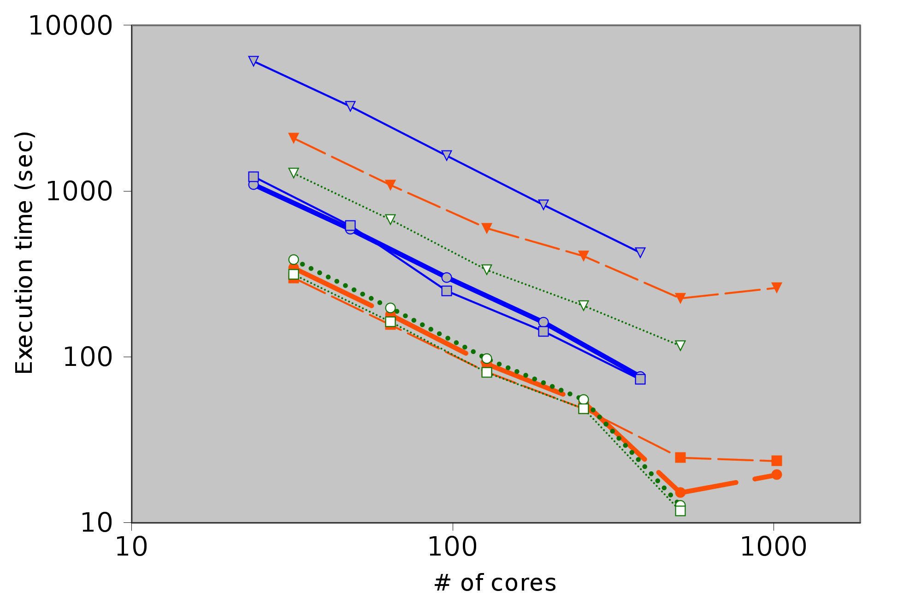



Performance
CGPOP
SWM
ISTeC Cray
Yellowstone
Gordon
The source-to-source translation tool removes library overhead.
Andrew Stone PhD Defense Slide 37

Slide 38
Summary: stencils
Expressivity:
  Compact and non-compact stencils within a bounded distance.
Performance:
  Function call overhead slows things down, but we can alleviate it with a source-to-source translator.
Programmability:
  Able to express stencil computations as if they were operating on a regular grid.
Andrew Stone PhD Defense Slide 38

Slide 39
Outline
Related Work
Grid Connectivity
Data\Computation Distribution
Stencil Computations
Communication
Conclusions
Publication Record
Andrew Stone PhD Defense Slide 39

Slide 40
Halos
Andrew Stone PhD Defense Slide 40

Slide 41
Halos
Andrew Stone PhD Defense Slide 41
Notes:
Talk about transfer aggregation

Slide 42
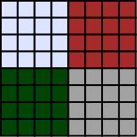
Planning communication
Before conducting communication generate a communication plan.
Communication plan includes:
  List of Messages to receive and send.
  What data to send/receive in a message.
  Who to receive/send a message from/to.
We determine what communication to conduct by finding out what blocks the halo intersects with.
If the halo reaches outside the subgrid look at border maps.
Andrew Stone PhD Defense Slide 42

Slide 43
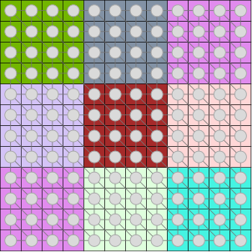
Non-compact stencil
Andrew Stone PhD Defense Slide 43

Slide 44
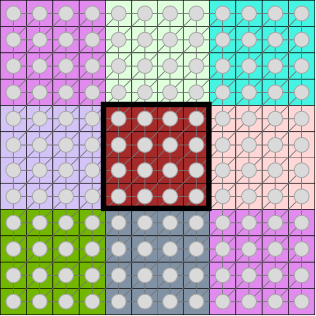
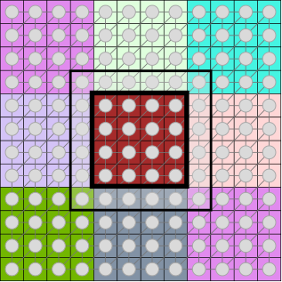
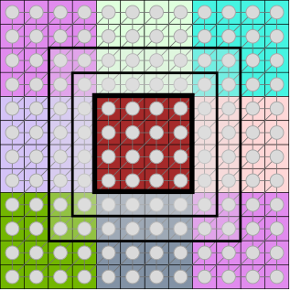
Halos for interior block
Andrew Stone PhD Defense Slide 44

Slide 45
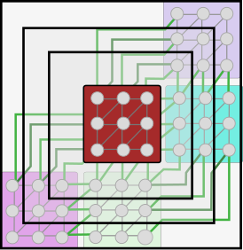

Halos for border blocks?
?
Andrew Stone PhD Defense Slide 45

Slide 46
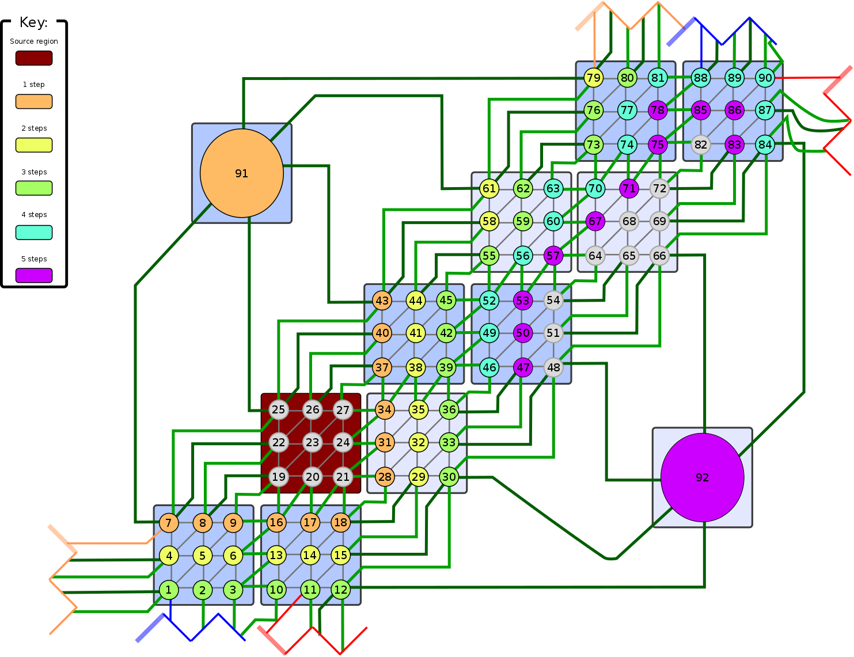
Ghost-cell lists
To conduct communication for non-compact stencils do a BFS around a block to see what nodes are accessible.
Conduct communication to transfer values.
Store values in sorted list (ghost-cells list), access through an indirection array
Andrew Stone PhD Defense Slide 46

Slide 47
Summary: communication
Expressivity:
Communication is invisible to the user. No control but no
responsibility.
Performance:
Costs more for larger halos, but difference shrinks as we scale the
number of cores up.
GridWeaver automatically aggregates messages.
Programmability:
Communication is invisible to the user. No control but no
responsibility.
Andrew Stone PhD Defense Slide 47

Slide 48
Outline
Related Work
Grid Connectivity
Data\Computation Distribution
Stencil Computations
Communication
Conclusions
Publication History
Andrew Stone PhD Defense Slide 48

Slide 49
Conclusions
Project goal:
To improve programmability and maintainability of stencil computations in Earth simulation applications.
Approach:
Identify the implementation concerns inherent in stencils for Earth simulation.
Separate concerns in a library and match performance with a source-to-source compilation tool.
Implementation concerns:
Grid connectivity
Data structure for grid values
Data distribution
Computation distribution
Stencil computation
Iteration order
Communication
. . . . . . . . Border map abstractions
. . . Stored in arrays
. . . . . . . . Functions to map blocks to procs
. . . . . Owner computes
. . . . . . . User written stencil operator function
. . . . . . . . Handled by GridWeaver
. . . . . . . . Automated by GridWeaver
Andrew Stone PhD Defense Slide 49

Slide 50
Conclusions
Evaluation:
Two case studies:
CGPOP
  Ocean simulation code.
  We implement both dipole and tripole versions.
  Tripole version is the same but with 2 additional lines to specify grid connectivity.
SWM
  Icosahedral grid.
  Non-compact stencil.
We maintain performance by eliminating library overhead by passing code through a source-to-source translation tool
Future Work:
Additional architectures, grids, and optimizations
Relaxing implementation limitations
  Higher dimensionality grids
  Generic data-types
Automatically identifying semi-regular portions in existing irregular grids
Andrew Stone PhD Defense Slide 50

Slide 51
Outline
Related Work
Grid Connectivity
Data\Computation Distribution
Stencil Computations
Communication
Conclusions
P Publication Record
Andrew Stone PhD Defense Slide 51

Slide 52
Dissertation work
Programming Abstractions to Separate Concerns in Semi-Regular Grids. Andrew Stone and Michelle Mills Strout. Proceedings of the 27th International Conference on Supercomputing (ICS) June 10, 2013.
Evaluating Coarray Fortran with the CGPOP Miniapp. Andrew I. Stone, John M. Dennis, and Michelle Mills Strout, Partitioned Global Address Space Conference. October 2011
Mechanisms that Separate Algorithms from Implementations for Parallel Patterns
Christopher D. Krieger and Andrew Stone and Michelle Mills Strout. Workshop on Parallel Programming Patterns (ParaPLOP). March 2010
Other work
Automatic Determination of May/Must Set Usage in Data-Flow Analysis. Andrew Stone and Michelle Mills Strout and Shweta Behere. International Working Conference on Source Code Analysis and Manipulation (SCAM). September 2008
May/Must Analysis and the DFAGen Data-flow Analysis Generator. Andrew Stone and Michelle Mills Strout and Shweta Behere. Information and Software Technology, 51(10) October 2009
Scalable Simulation of Complex Network Routing Policies. Andrew I. Stone and Steven DiBenedetto and Michelle Mills Strout and Daniel Massey. The Proceedings of the ACM International Conference on Computing Frontiers (CF) 2010
Andrew Stone PhD Defense Slide 52

Slide 53
Acknowledgements
Advisor: Michelle Strout
Commitee:
Daniel Massey
Shirdeep Palickara
David Randell
Miniapp developers \ support:
CGPOP: John Dennis
SWM: Ross Heikes
Machines access \ support:
ISTeC Cray (Colorado State)
XSede Startup Allocation
NCAR University Allocation
Andrew Stone PhD Defense Slide 53

