Slide 1
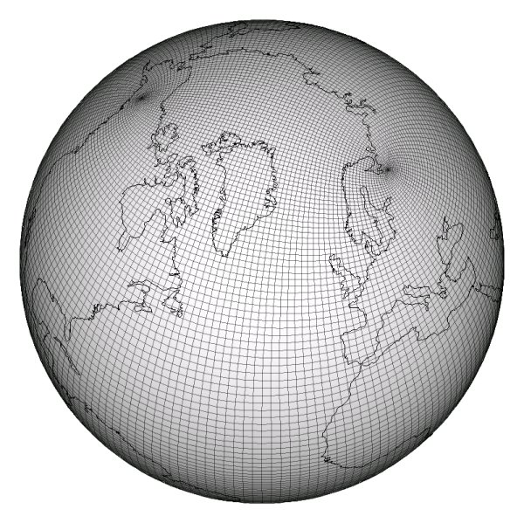
Abstractions for, and Generation of, Semi-Regular Grid Computations
Andy Stone
Aug 15, 2012
Andrew Stone Dissertation proposal Slide 1

Slide 2
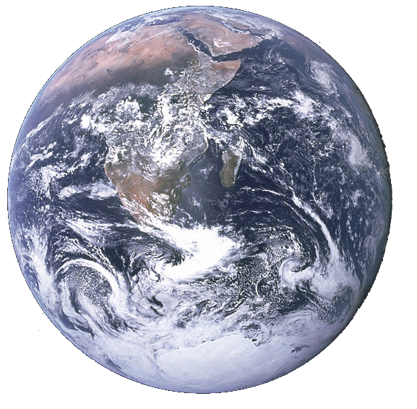
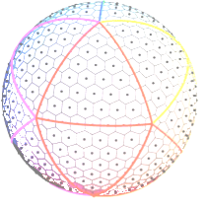
Motivation
Scientists use Earth Simulation programs to:
  Predict change in the weather and climate
  Gain insight into how the climate works
Components include: ocean, land-surface, sea ice, atmosphere
Performance is crucial: it impacts time-to-solution and accuracy
Discretize!
Apply a stencil!
Andrew Stone Dissertation proposal Slide 2

Slide 3
Problem: Implementation details tangle code
  Loop {
  communicate()
  stencil()
  }
Stencil function
5% CGPOP
1.5% SWM
Grid structure
Stencil
Data decomposition
Optimizations
Communication function
19% CGPOP
30% SWM
Generic stencil and communication code isn’t written due to need for performance.
Andrew Stone Dissertation proposal Slide 3
Notes:
SWM 7078 SLOC 109
SLOC 3000 SLOC 301

Slide 4
SWM stencil code
x2(:,:) = zero
DO j = 2,jm-1
DO i = 2,im-1
x2(i,j) = area_inv(i,j)* &
((x1(i+1,j )-x1(i,j))*laplacian_wghts(1,i,j)+ &
(x1(i+1,j+1)-x1(i,j))*laplacian_wghts(2,i,j)+ &
...
ENDDO
ENDDO
! NORTH POLE
i = 2; j = jm
x2(i,j) = area_inv(i,j)*laplacian_wghts(1,i,j)*((x1(i+1,j)- ...
! SOUTH POLE
i = im; j = 2
x2(i,j) = area_inv(i,j)*laplacian_wghts(1,i,j)*((x1( 1, jm)- ...
Andrew Stone Dissertation proposal Slide 4
Notes:
This pattern appears multiple times

Slide 5
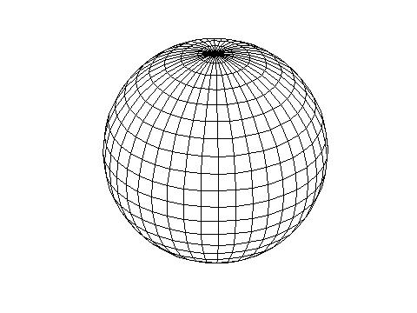
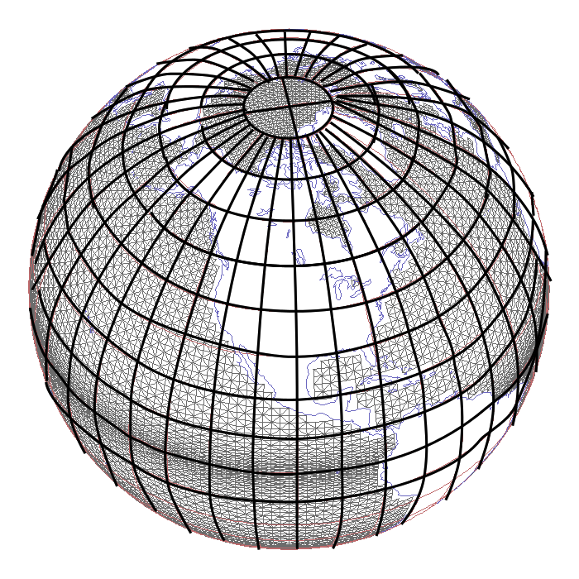
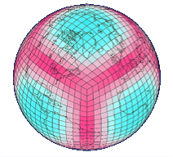
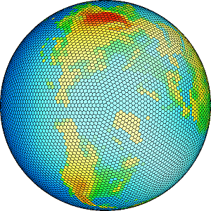
Earth Grids
Lat/Lon
Tripole
Cubed Sphere
Geodesic
Andrew Stone Dissertation proposal Slide 5
Notes:
This pattern appears multiple times

Slide 6
Proposed solution
Create set of abstractions to separate details
  Subgrids, border maps, grids, distributions, communication plans, and data objects
Provide abstractions in a library: GridLib
Use code generator to remove library overhead and optimize: GridGen
Andrew Stone Dissertation proposal Slide 6

Slide 7
Talk outline
Background
Related work
Proposed work
Project organization
Andrew Stone Dissertation proposal Slide 7

Slide 8
Background
Andrew Stone Dissertation proposal Slide 8

Slide 9
Background:
Grid structure
Parallelization and data decomposition
Optimization
Andrew Stone Dissertation proposal Slide 9

Slide 10
Grid abstractions
Irregular
✔
Most general
Structured with a graph
Connectivity is explicitly stored
✗
Regular
✗
Restricted to tessellation of rectangular
space with equal sized rectangles
Structured with an array
Storage efficient
i
j
✔
Andrew Stone Dissertation proposal Slide 10

Slide 11
Impact on code
Generic:
for each cell c
c = sum(neighbors(c))
Irregular
for x = 1 to n
for neigh = 1 to numNeighs(x)
A(x) += A(neighbor(x, neigh))
Regular
Structured with an array
Storage efficient
for i = 1 to n
for j = 1 to m
A(i,j) = A(i-1, j) + A(i+1, j) +
A(i, j-1) + A(i, j+1)
i
j
Andrew Stone Dissertation proposal Slide 11

Slide 12
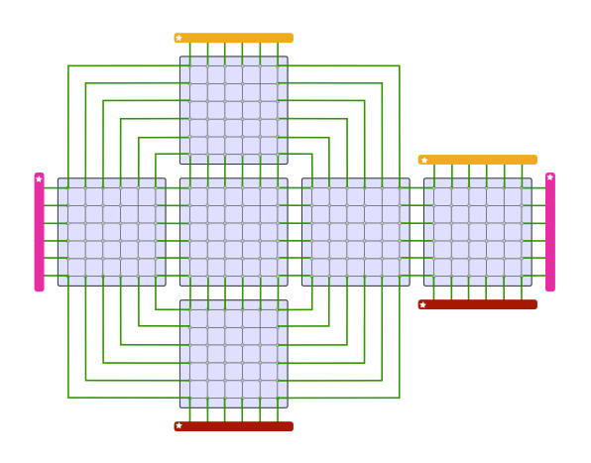
Many Earth grids are not purely regular
This is the structure of the cubed-sphere grid
Set of regular grids (arrays)
Connected to one another in an irregular fashion
Specialized communication code is needed to handle the irregular structure.
Andrew Stone Dissertation proposal Slide 12

Slide 13
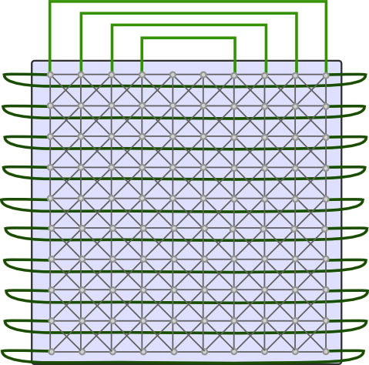

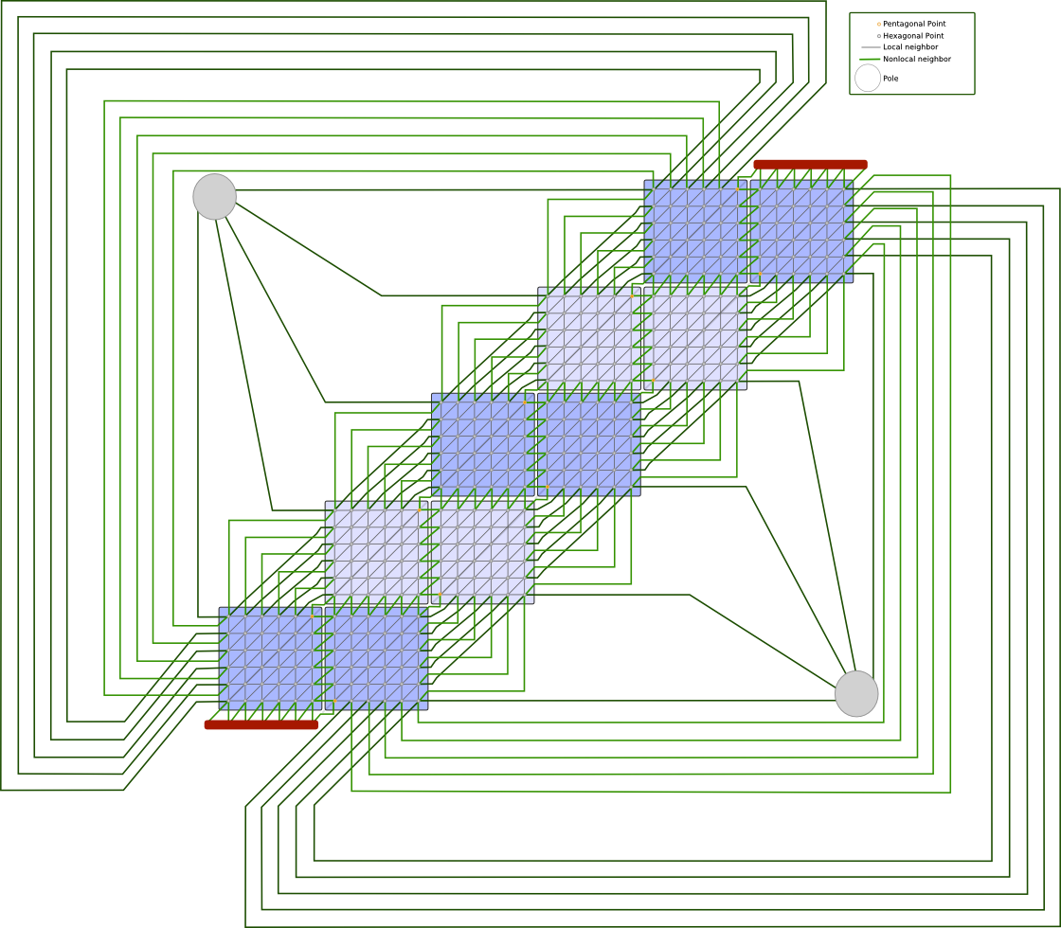
Semi-regular grid examples
Dipole
Tripole
Icosahedral
Cubed Sphere
Andrew Stone Dissertation proposal Slide 13

Slide 14
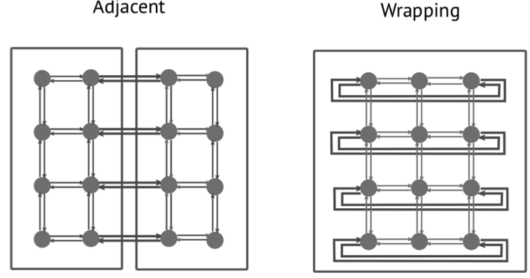
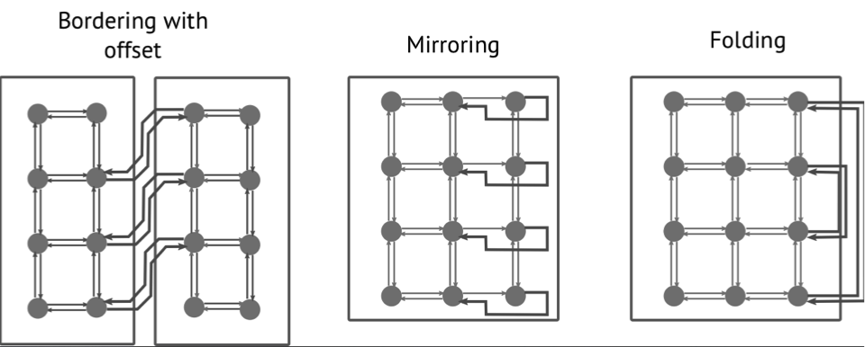
Connectivity between subgrids
Dipole:
Wrapping
Cubed Sphere:
Adjacent
Tripole:
Wrapping, folding
Icosahedral:
Adjacent, offset
Andrew Stone Dissertation proposal Slide 14

Slide 15
Domain decomposition for parallelization
How to map data and computation onto processors?
Andrew Stone Dissertation proposal Slide 15

Slide 16
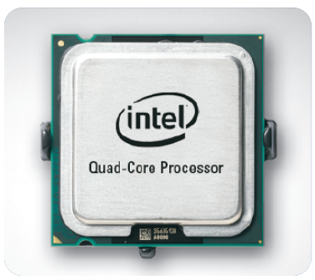
Domain decomposition for parallelization
How to map data and computation onto processors?
Andrew Stone Dissertation proposal Slide 16

Slide 17

Domain decomposition for parallelization
How to map data and computation onto processors?
Andrew Stone Dissertation proposal Slide 17

Slide 18
Domain decomposition for parallelization
How to map data and computation onto processors?
Andrew Stone Dissertation proposal Slide 18

Slide 19
Common optimizations
Better locality:
  Tiling: Group computation into blocks for locality
Array of structs: Pack multiple properties of grid together
Array padding: Start and end arrays on cache lines
Use of special hardware:
  SIMDization: Use special hardware (ex: SSE instructions) to perform the same computation on multiple pieces of data simultaneously
Hiding or Reducing Communication:
  Overlap computation and communication
  Perform redundant computation to avoid communication
Andrew Stone Dissertation proposal Slide 19

Slide 20
Related work
Andrew Stone Dissertation proposal Slide 20

Slide 21



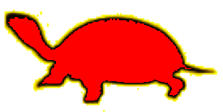
Related work: Grid structure
Arrays
Graphs
Wrapping
Mirroring
Adjacent
Offset
Folding
Arbitrary
ZPL’s regions (‘98) | ✔ |  | ✔ | ✔
Chombo (‘09) | ✔ |  | ✔
Kamil et. al (‘09) | ✔ |  | ✔
Mint (‘11) | ✔ |  | ✔
Patus (‘11) | ✔ |  | ✔
Physis (‘11) | ✔ |  | ✔
Pocohir (‘11) | ✔ |  | ✔
OP2 (‘10) |  | ✔ | ✔ | ✔ | ✔ | ✔ | ✔ | ✔
Liszt (‘11) |  | ✔ | ✔ | ✔ | ✔ | ✔ | ✔ | ✔
Proposed Work | ✔ |  | ✔ | ✔ | ✔ | ✔ | ✔ | ✔
Andrew Stone Dissertation proposal Slide 21

Slide 22
Related work: Optimizations
Redundant Comp.
Array-of-structs
SIMDization
Time skewing
Comm. Hiding
Autotunes
Arrays
Graphs
Tiling
ZPL (’98) | ✔
Chombo (’09) | ✔
Kamil et al. (’09) | ✔ |  |  | ✔ |  |  |  |  | ✔
Mint (’11) | ✔ |  |  | ✔
Patus (’11) | ✔ |  | ✔ |  |  |  |  |  | ✔
Physis (’11) | ✔ |  |  |  |  | ✔
Pocohir (’11) | ✔ |  |  |  | ✔
OP2 (’10) |  | ✔ |  |  |  |  | ✔
Liszt (’11) |  | ✔
Proposed Work | ✔ |  |  |  |  | ✔ | ✔ | ✔
Andrew Stone Dissertation proposal Slide 22

Slide 23
Proposed work
Andrew Stone Dissertation proposal Slide 23

Slide 24
Proposed project
Goal:
To enable a separation of concerns for semi-regular grid computations between stencil algorithm and: (1) grid structure, (2) parallelization and decomposition details, and (3) optimization without sacrificing performance.
Miniapps:
CGPOP (ocean simulation)
SWM (shallow water model)
Grids:
Dipole, Tripole, Cubed Sphere, Icosahedral
Machines:
Department’s Bacon & Eggs (16 cores)
ISTEC Cray (1248 cores)
NCAR YellowStone (72,288 cores)
Andrew Stone Dissertation proposal Slide 24

Slide 25
Example Code
! Define grid
call sugrid_new(sg1, N, M)
call sugrid_new(sg2, N, M)
call grid_new(g)
call grid_placeAdjacentWE(g, sg1, sg2)
! Define distribution and read in data
call distribution_new_blocked(dist, g, 100, 100)
call data_new_from_file(data_in, “input.dat”, g, dist)
! Apply stencil
data_out = data_apply(data_in, fourPtAvg)
real function fourPtAvg(A, i, j)
fourPtAv = &
0.2 * (A(i,j) + A(i-1,j) + &
A(i+1, j) + A(i, j-1) + &
A(i, j+1))
end function
Andrew Stone Dissertation proposal Slide 25

Slide 26
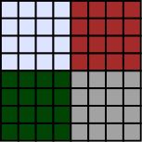
Communication plan
Andrew Stone Dissertation proposal Slide 26

Slide 27
Proposed project
Input Data
Fortran Compiler
Debug Path
Program
Fortran Program w/ GridLib Calls
GridGen
Performance path
Optimized program
GridLib
Andrew Stone Dissertation proposal Slide 27

Slide 28
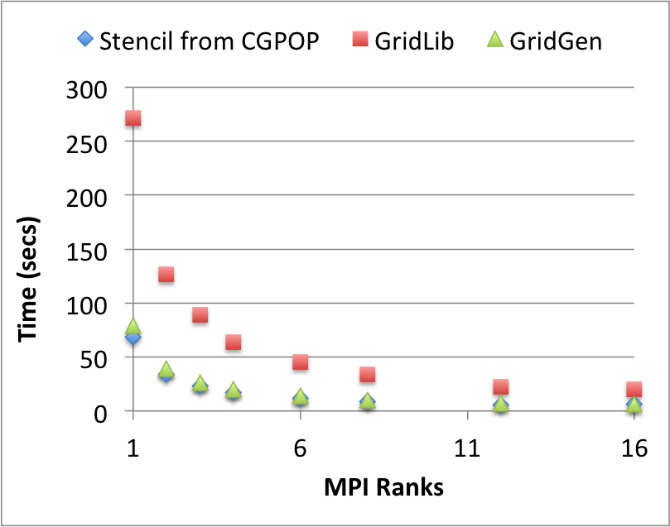
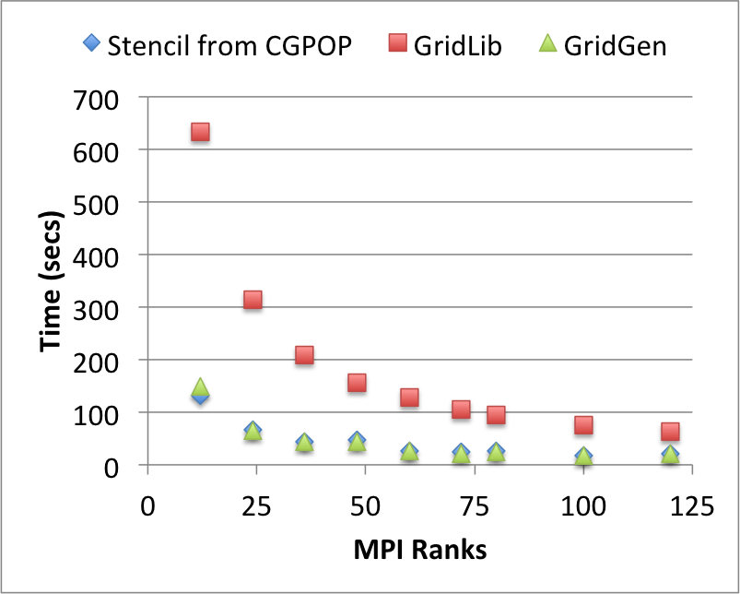
Preliminary results
Implementation of stencil from CGPOP on a dipole grid
Goal: To Have GridGen match performance of handwritten code
Shared Memory Machine
Distributed Memory Machine
Bacon, a 16 core, 2.13 GHz, XeonE7 machine
100 iterations, 3600 x 3600 grid
Cray XT6m with 1248 cores across 52 nodes,
24 cores per node
1000 Iterations, 10800 x 10800
Andrew Stone Dissertation proposal Slide 28

Slide 29
Proposed solution:
Grid Structure
SubGrids
Border Mappings
Grids
Convenience Functions
Parallelization and data decomposition
Distribution objects
Convenience Functions
Targets clusters using MPI
Optimization
Users specify what optimizations to apply
Optimizing Generators
Andrew Stone Dissertation proposal Slide 29

Slide 30
What we have done:
Grid Structure
✔
SubGrids
Border Mappings
Grids
Convenience Functions
✔
Parallelization and data decomposition
Distribution objects
Convenience Functions
Targets clusters using MPI
Optimization
Users specify what optimizations to apply
Optimizing Generators
Limitation: Compact stencils only
Andrew Stone Dissertation proposal Slide 30

Slide 31
Project organization
Andrew Stone Dissertation proposal Slide 31

Slide 32
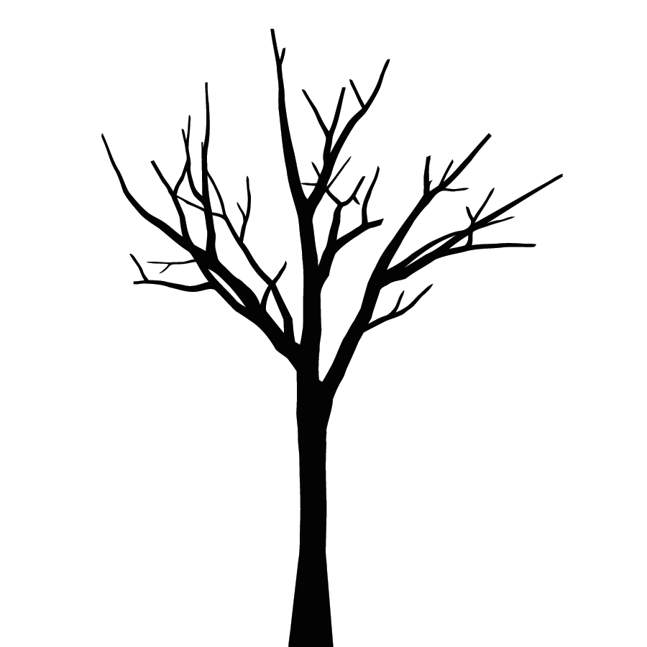
Project organization
Three Papers
2012
Summer (now)
How do we prevent tangling semi-structured grid topology with stencil algorithm?
Submit to: IPDPS (October)
Fall
How do we generalize our previous approach for non-compact stencils?
Submit to: PLDI (November)
Spring
What Optimizations can we automatically apply to semi-regular grid code, and how do we apply these optimizations?
Submit to: SC (April)
2013
Summer 2013
Compile this work into a dissertation
Andrew Stone Dissertation proposal Slide 32

Slide 33
Paper one
2012
Problem: How do we prevent tangling semi-structured grid topology with a stencil algorithm?
Solution: Create semi-regular grid abstractions. Integrate into a library.
Sub problems:
How do we perform communication for any semi-regular grid?
How can we ensure we match hand written performance?
Solution:
Have a generic communication algorithm to populate halos and generate a communication plan to direct it for a specific grid.
Aggregate messages
Use a code generation tool to inline library calls.
Experimentation Goal:
Enable separation without sacrificing performance for small, example stencils extracted from CGPOP and SWM on dipole, tripole, and cube-sphere grids when run on a cluster.
Andrew Stone Dissertation proposal Slide 33

Slide 34
Paper two
Problem: How do we generalize our previous approach for non-compact stencils? Does my approach work for real-world applications?
Solution:
New border maps abstraction
Time dimension in data objects
Use tools with SWM and CGPOP
Challenges:
Getting SWM and CGPOP to pass through frontend
Maintaining SWM and CGPOP performance
Developing border map abstraction
Experimentation Goal:
Maintain separation without sacrificing performance when applied to CGPOP and SWM. Replace stencils in CGPOP and SWM with stencils that have greater depth and/or refer to more than one timestep back.
Andrew Stone Dissertation proposal Slide 34

Slide 35
Paper three
Problem: How do we improve the performance of CGPOP and SWM
without tangling code or requiring a large rewrite?
Solution: Have a tool automatically apply optimizations when given a grid and
algorithm specification.
Challenges: Determining what optimizations would be the most useful to apply
Experimentation Goal:
Improve the performance of CGPOP and SWM without changing the SWM or CGPOP code.
Andrew Stone Dissertation proposal Slide 35

Slide 36
Summary
Goal:
To enable a separation of concerns for semi-regular grid computations between stencil algorithm and: (1) grid structure, (2) parallelization and decomposition details, and (3) optimization without sacrificing performance.
Semi-regular grid computations appear in Earth simulation applications.
Existing stencil generators do not focus on semi-regular grids.
Contributions:
Introduction of abstractions
Design of communication plan algorithm
Development GridLib library and GridGen tool
Evaluation with CGPOP and SWM
Adapting optimizations for semi-regular grids and automatically applying them
Plan:
3 papers
Finish Summer 2013
Andrew Stone Dissertation proposal Slide 36

Slide 37


Questions?
Andrew Stone Dissertation proposal Slide 37

Slide 39
Paper One: Tools
2012
Andrew Stone Dissertation proposal Slide 39

Slide 40
Parallelization Complicates Code
// distribute
is = 1; ie = n
js = pid * 2; je = js+1
communicate();
for i = is to ie
for j = js to je
A(i,j) = A(i-1, j) + A(i+1, j) +
A(i, j-1) + A(i, j+1)
distribute()
communicate()
for x = ns to ne
for neigh = 1 to numNeighs(x)
A(x) += A(neighor(x, neigh))
Andrew Stone Dissertation proposal Slide 40

Slide 41
Resolution to Tangling Details:
Grid Structure
  For my dissertation:
    Create a set of abstractions for:
    semi-regular grids
    data decompositions
    algorithms on grids
    I will incorporate these abstractions into a library called GridLib, and code generation tool called GridGen
    I will target clusters using MPI.
    And apply optimizations when specified by the user
Abstractions to represent grid: Node, Edge, Cell, Field
Parallelization and data decomposition
Decomposition functions
Generators for: MPI, OpenMP, CUDA
Optimization
Automatically Apply
Apply via tool
Autotune
Andrew Stone Dissertation proposal Slide 41

Slide 42
Methods of Detangeling:
Grid Structure
Abstractions to represent grid: Node, Edge, Cell, Field
Parallelization and data decomposition
Decomposition functions
Generators for: MPI, OpenMP, CUDA
Optimization
Automatically Apply
Apply via tool
Autotune
Andrew Stone Dissertation proposal Slide 42

Slide 43
Stencil Generation Tools
 | Regular | Irregular | Output Language | Multicore | Clutser | GPU
Kamil et al. | ✔ |  | C, Fortran, pthreads | ✔
Mint | ✔ |  | C, CUDA |  |  | ✔
Patus | ✔ |  | C, Openmp, CUDA | ✔ |  | ✔
Physis | ✔ |  | C , CUDA |  | ✔ | ✔
Pocohir | ✔ |  | C++, Cilk | ✔
Chombo | ✔ |  | C++, MPI |  | ✔
Liszt |  | ✔ | C++, MPI, CUDA |  | ✔ | ✔
OP2 |  | ✔ | C++, MPI OpenMP, CUDA |  | ✔ | ✔
ZPL | ✔ |  | C, PGAS Library |  | ✔
Proposed Work | ✔ |  | MPI |  | ✔
Andrew Stone Dissertation proposal Slide 43

Slide 44
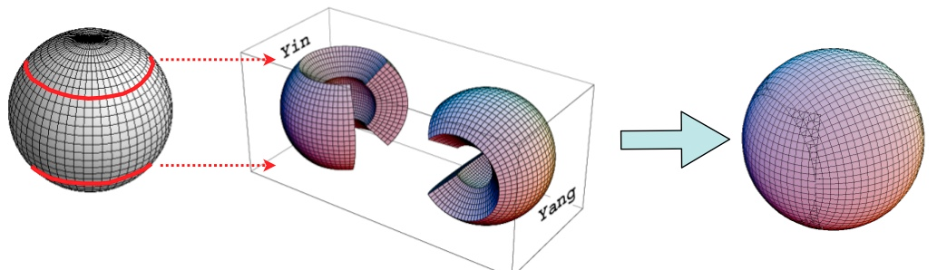
Limitations of planned research
Adaptive
Yin Yang
http://www.research.kobe-u.ac.jp/csi-viz/research/index.ja.html
Andrew Stone Dissertation proposal Slide 44

Slide 45
Future Work
Other types of grids:
Higher-dimensionality
Adaptively Refined
Yin Yang
Unstructured
Additional Evaluation:
Applied in larger apps
Additional miniapps
Other Frontends and backends:
C/C++, HPCC languages (Chapel, X10)
GPUs
Additional Optimizations
Andrew Stone Dissertation proposal Slide 45

Slide 46
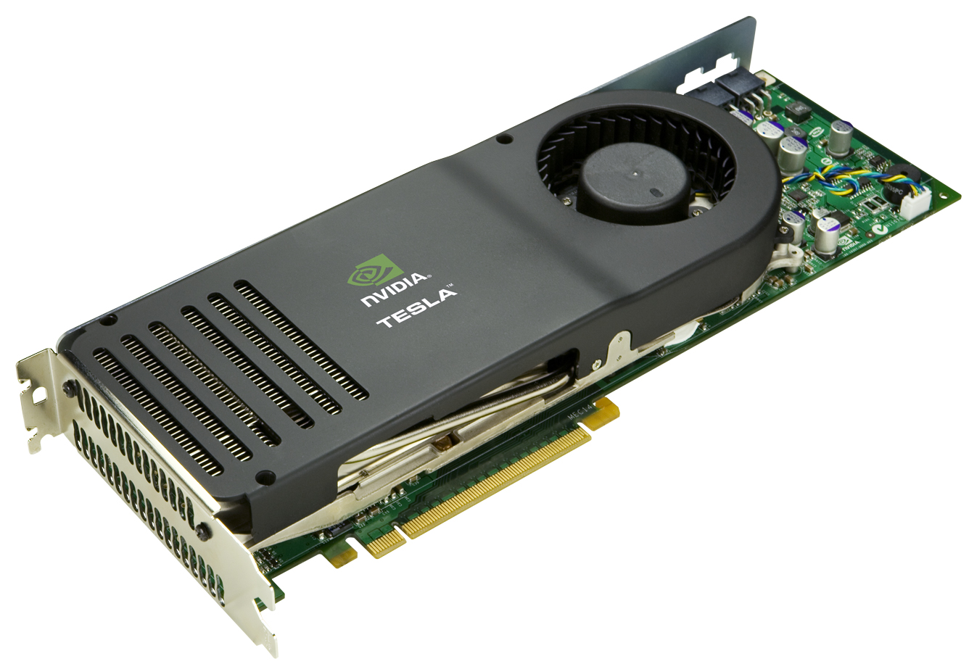

Parallelization Targets
MultiCore Machines:
Multiple processors with shared memory
OpenMP, Cilk, pThreads
GPUs
Massive SIMD processing
OpenCL, CUDA
Clusters
Networked collection of machines
MPI
Andrew Stone Dissertation proposal Slide 46

