Slide 1

Scalable Simulation Of Complex Network Routing Policies
Andrew Stone, Michelle Strout, Steven DiBenedetto, and Daniel Massey
Colorado State University
May 19, 2010
Computing Frontiers
Andrew Stone -- Colorado State University Slide 1

Slide 2
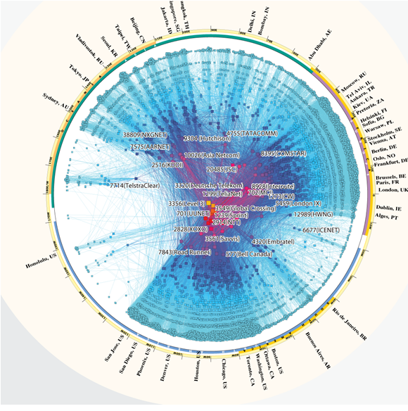
People who study networks, want to analyze this:
Andrew Stone -- Colorado State University Slide 2
Notes:
Shrink image:
- Experimentally produced model of internet topology
- Nodes are ISPs (Autonomous systems)
- 35K (Actuall have this one)!!
- Researchers want to simulate routing on this topology
- Results: routing tables
- No existing work can scale to this problem
- But our work can, and has:
- Current work: Networking researchers are using this simulator to compare the resulting routing tables to actual routing tables.
- Based on this we're coming up with ideas to improve accuracy of topology and better model protocol.
- Leading to future research
"Opening a research frontier"
---------------------------------------------
Internet toplogy between domains
Simulate different protocols (BGP)
Verify models and models of policy
Each node is an autonomous system (ISP)
35K nodes
<differences come in through the edge labels>
Points to explicitly add:
- 35 K nodes
- want to simulate BGP
- Want to get routing tables BGP
Use the phrase "could not do before"

Slide 3
About this model:
This is a model of the internet
Experimentally produced
Nodes are autonomous systems (ISPs)
33K nodes
source: http://www.caida.org/home/
Andrew Stone -- Colorado State University Slide 3
Notes:
Shrink image:
- Experimentally produced model of internet topology
- Nodes are ISPs (Autonomous systems)
- 35K (Actuall have this one)!!
- Researchers want to simulate routing on this topology
- Results: routing tables
- No existing work can scale to this problem
- But our work can, and has:
- Current work: Networking researchers are using this simulator to compare the resulting routing tables to actual routing tables.
- Based on this we're coming up with ideas to improve accuracy of topology and better model protocol.
- Leading to future research
"Opening a research frontier"
---------------------------------------------
Internet toplogy between domains
Simulate different protocols (BGP)
Verify models and models of policy
Each node is an autonomous system (ISP)
35K nodes
<differences come in through the edge labels>
Points to explicitly add:
- 35 K nodes
- want to simulate BGP
- Want to get routing tables BGP
Use the phrase "could not do before"

Slide 4
Analyze what?
Researchers want to know:
  How accurate this modeled topology is
  how topology affects routing tables
  how policy affects
  routing tables
Andrew Stone -- Colorado State University Slide 4
Notes:
Shrink image:
- Experimentally produced model of internet topology
- Nodes are ISPs (Autonomous systems)
- 35K (Actuall have this one)!!
- Researchers want to simulate routing on this topology
- Results: routing tables
- No existing work can scale to this problem
- But our work can, and has:
- Current work: Networking researchers are using this simulator to compare the resulting routing tables to actual routing tables.
- Based on this we're coming up with ideas to improve accuracy of topology and better model protocol.
- Leading to future research
"Opening a research frontier"
---------------------------------------------
Internet toplogy between domains
Simulate different protocols (BGP)
Verify models and models of policy
Each node is an autonomous system (ISP)
35K nodes
<differences come in through the edge labels>
Points to explicitly add:
- 35 K nodes
- want to simulate BGP
- Want to get routing tables BGP
Use the phrase "could not do before"

Slide 5
Ideally, they want a simulator that:
shows resulting routing tables
can work with large topologies (30k - 100k nodes)
can work with various policies
can produce results quickly (overnight)
works with accessible hardware
Andrew Stone -- Colorado State University Slide 5
Notes:
Shrink image:
- Experimentally produced model of internet topology
- Nodes are ISPs (Autonomous systems)
- 35K (Actuall have this one)!!
- Researchers want to simulate routing on this topology
- Results: routing tables
- No existing work can scale to this problem
- But our work can, and has:
- Current work: Networking researchers are using this simulator to compare the resulting routing tables to actual routing tables.
- Based on this we're coming up with ideas to improve accuracy of topology and better model protocol.
- Leading to future research
"Opening a research frontier"
---------------------------------------------
Internet toplogy between domains
Simulate different protocols (BGP)
Verify models and models of policy
Each node is an autonomous system (ISP)
35K nodes
<differences come in through the edge labels>
Points to explicitly add:
- 35 K nodes
- want to simulate BGP
- Want to get routing tables BGP
Use the phrase "could not do before"

Slide 6
The Problem
Existing simulators:
  Only work with small topologies
  Have hardcoded policies
Complicating factors:
  How to specify policy?
  Policies are more than just shortest path
  O(n^2) memory requirements for routing tables
To 2: 2
To 3: 3
To 4: 2
1
To 1: 1
To 3: 1
To 4: 4
2
To 1: 1
To 2: 1
To 4: 4
3
4
To 1: 2
To 2: 2
To 3: 3
Andrew Stone -- Colorado State University Slide 6
Notes:
Why we can address this:
- RAML
- Because of mathematical properties on RAML, we can pose the simulator as an pleasantly parallel problem and we can break up the problem to reduce the O(n^2) memory bound to O(n) at any one time.

Slide 7
MR. Sim
Our tool: MR.Sim
  Inputs topologies: specification file
  Inputs policies: Metarouting based framework
  Parallelism: embarrassingly parallel through simulation segmentation
    reduces O(n^2) memory requirements to O(n) at any one time
Andrew Stone -- Colorado State University Slide 7

Slide 8
How a topology is modeled
Nodes = autonomous systems
Edges = connections
Edge labels describe the connection and influence policy
1
2
p
p
c
c
c
p
Examples of connections
c: customer connection
r: peer connection
p: provider connection
r
4
3
r
p
p
p
c
c
c
5
6
7
Andrew Stone -- Colorado State University Slide 8

Slide 9
How topologies are input to Mr. Sim
Map files list the edges in the network graph and the policies (labels) that are on those edges.
SimpleNet.map
1 2 c
2 1 p
1 3 c
3 1 p
2 3 r
3 2 r
2 4 c
4 2 p
2 5 c
5 2 p
1
p
p
c
c
r
3
2
r
p
p
c
c
4
5
Andrew Stone -- Colorado State University Slide 9
Notes:
Where map files come in?

Slide 10
Routing Policies
RAML: Routing Algebra Meta Language
Routing algebras
Composition operators
Routing algebras represent policies
RAML policies are guaranteed to converge
Andrew Stone -- Colorado State University Slide 10

Slide 11

Routing Algebras
All about signatures and labels
Labels describe: connections
Signatures describe: routes
Signatures give routes some value
A route is: (destination, next-hop, signature)
Andrew Stone -- Colorado State University Slide 11

Slide 12





Routing Algebras
Set of possible signatures
Label operator
Preference relation (partial ordering of sigs)
Originator set (possible signatures initial routes can have)
Set of possible labels
Andrew Stone -- Colorado State University Slide 12

Slide 13
Propagating routes
A route is: (destination, next-hop, signature) = {C, R, P} L = {c, r, p}
Signature determines how C < R < P
preferred a route is smaller is more preferred.
Nodes propagate routes to neighbors. Neighbors update their routing tables based on the propagated information.
Dest | Nh | Sig
1 | 1 | C
Hey 4, I’ve got this route to 1
2
p
c
Great, I’ll update my table to include that. The sig changes to R though.
1
p
r
r
4
c
r
Dest | Nh | Sig
1 | ? | ?
3
p
Dest | Nh | Sig
1 | 2 | R
Dest | Nh | Sig
1 | 1 | R
Andrew Stone -- Colorado State University Slide 13

Slide 14
Propagating routes
A route is: (destination, next-hop, signature) = {C, R, P} L = {c, r, p}
Signature determines how C < R < P
preferred a route is smaller is more preferred.
When a route is propagated it is compared against any existing routes to the same destination. The table is only updated if the new route is more preferred than the current one.
Dest | Nh | Sig
1 | 1 | C
Hey 4, do you want to use this route to 1?
No way, the route that way will have a signature of P! I’ll keep what I’ve got.
2
p
c
1
p
r
r
4
c
r
Dest | Nh | Sig
1 | ? | ?
3
p
Dest | Nh | Sig
1 | 2 | R
Dest | Nh | Sig
1 | 1 | R
Andrew Stone -- Colorado State University Slide 14

Slide 15
Mr. Sim Classes:
Mr. Sim model’s routing algebras in a C++ framework. Users override these classes to define various properties of the algebra.
The framework includes the following abstract classes:
Signature
Label
PreferenceRelation
LabelOperator
NetworkReader
Algebra
Algebra is passed a PreferenceRelation, LabelOperator, and NetworkReader
Andrew Stone -- Colorado State University Slide 15

Slide 16
BGP Policy
FM(LP(3))
= {0, 1, 2}
L = {0, 1, ...}
(lbl, sig) = rhs > lhs then phi else lhs
SIMSEQ(0, N-1)
= {0, 1, .., N-1}
L = {0, 1, ..., N-1}
(lbl, sig) = addtolist(lbl)
RouteID()
= {0, 1, ..}
L = {0, 1, ...}
(lbl, sig) = lbl
BGP = FM(LP(3)) X SIMSEQ(0, N-1) X RouteID
Andrew Stone -- Colorado State University Slide 16

Slide 17
BGP Policy
1 FMIntOp fmOp;
2 SimSeqOp seqOp;
3 LpOp lpOp;
4 LPInt prefRel;
5 SeqPref seqPref;
6 BGPRelationshipReader relationshipReader;
7 RouteIDReader routeIDReader;
8
9 // create the three algebras BGP is composed of
10 Algebra algFMLP(
"FMLP", &fmOp, &prefRel, &relationshipReader);
11 Algebra algAdd(
"SIMSEQ", &seqOp, &seqPref, &routeIdReader);
12 Algebra algRouteID(
"RouteID", &lpOp, &prefRel, &routeIDReader);
13
14 // calculate the composed routing algebra (the BGP
15 // policy). First parameter specifies number of
16 // algebras to compose
17 Algebra bgp = Algebra::lexProduct(
3, &algFMLP, &algAdd, &algRouteID);
Andrew Stone -- Colorado State University Slide 17

Slide 18
Simulation Segmentation
network | memory usage
1k nodes | 57 MB
10k nodes | 6.88 GB
30k nodes | could not test
internet (33k nodes) | could not test
All route's simulation has O(n^2) memory requirement
Swapping kills performance
Due to how we model the routing problem it is possible to do a set of simulations that each only solve the problem for a set of routes.
First just find routes to these nodes:
Then find routes to these nodes:
Andrew Stone -- Colorado State University Slide 18
Notes:
Steve: How much HD space does this take?
Where does Internet graph come from?

Slide 19
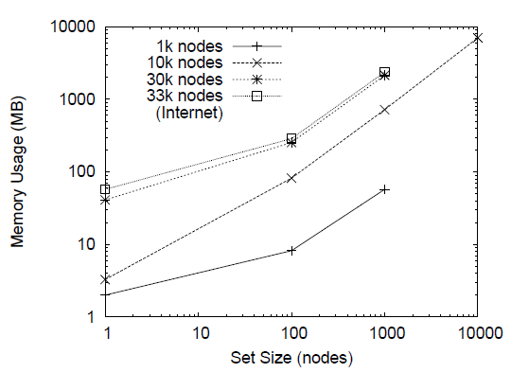
How set size affects memory usage
(simple policy)
Andrew Stone -- Colorado State University Slide 19

Slide 20
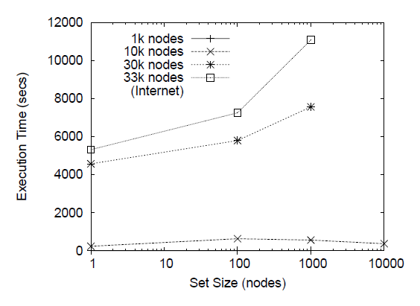
How set size affects performance
(simple policy)
Andrew Stone -- Colorado State University Slide 20

Slide 21
Shared Memory Scalability
Andrew Stone -- Colorado State University Slide 21

Slide 22
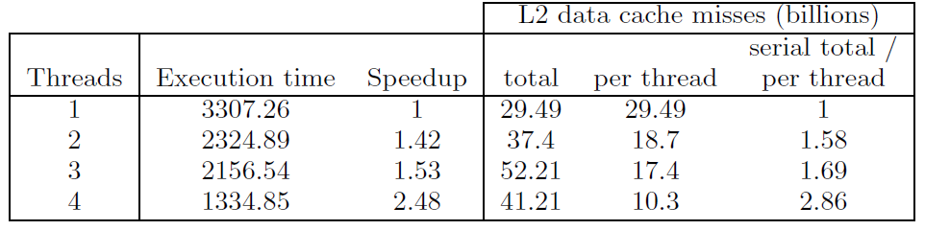
Shared Memory Scalability
Effective cache size is preventing ideal speedup
(cache per thread goes down as # of threads goes up)
Andrew Stone -- Colorado State University Slide 22

Slide 23
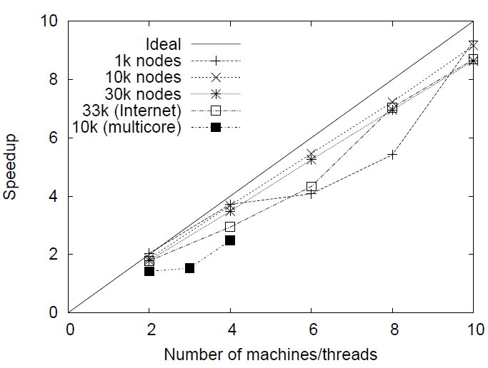
Distributed Memory
Scalability
Andrew Stone -- Colorado State University Slide 23

Slide 24
Conclusions
Our tool:
Can input topologies via specification file
Includes a C++ framework based on metarouting
Can operate with BGP on internet topology
This tool is being used to conduct internet-routing research
Topologies are only going to get more complicated
Scalability:
We didn't get it on a shared memory architecture
(due to shared cache)
Do did get it on a distributed memory architecture
We've succeeded in our goal (43 min simulation on 10 machines)
Andrew Stone -- Colorado State University Slide 24

Slide 25
Questions?
Andrew Stone -- Colorado State University Slide 25

